Slide 1
How to use the template:
Your printed out poster will be 39” (width) by 26” (height). This template should already have these margins set up correctly under “Page Setup”. E-mail to me a single correctly formatted powerpoint slide.
Your poster should include a picture of your group either in one group photo or as set of individual pictures. The photo(s) should be captioned by your names.
Most posters should have the following components:
Names, date, school logo and group or individual photos.
Research Question
Theoretical Framework
Experimental Setup
Data
Analysis
Conclusion
On page 2, you will find a sample of an old poster. Most posters should have a lot of space dedicated to photos, diagrams and graphs. Words should be in a large font and kept concise.

Slide 2
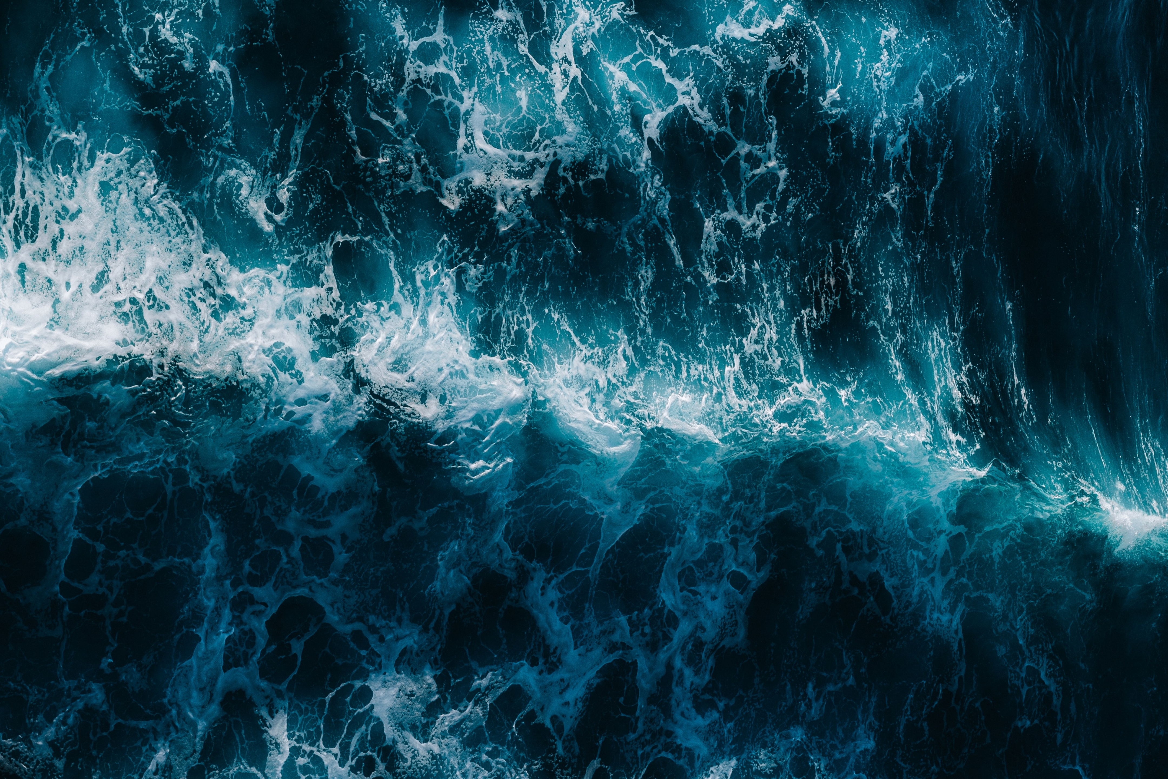
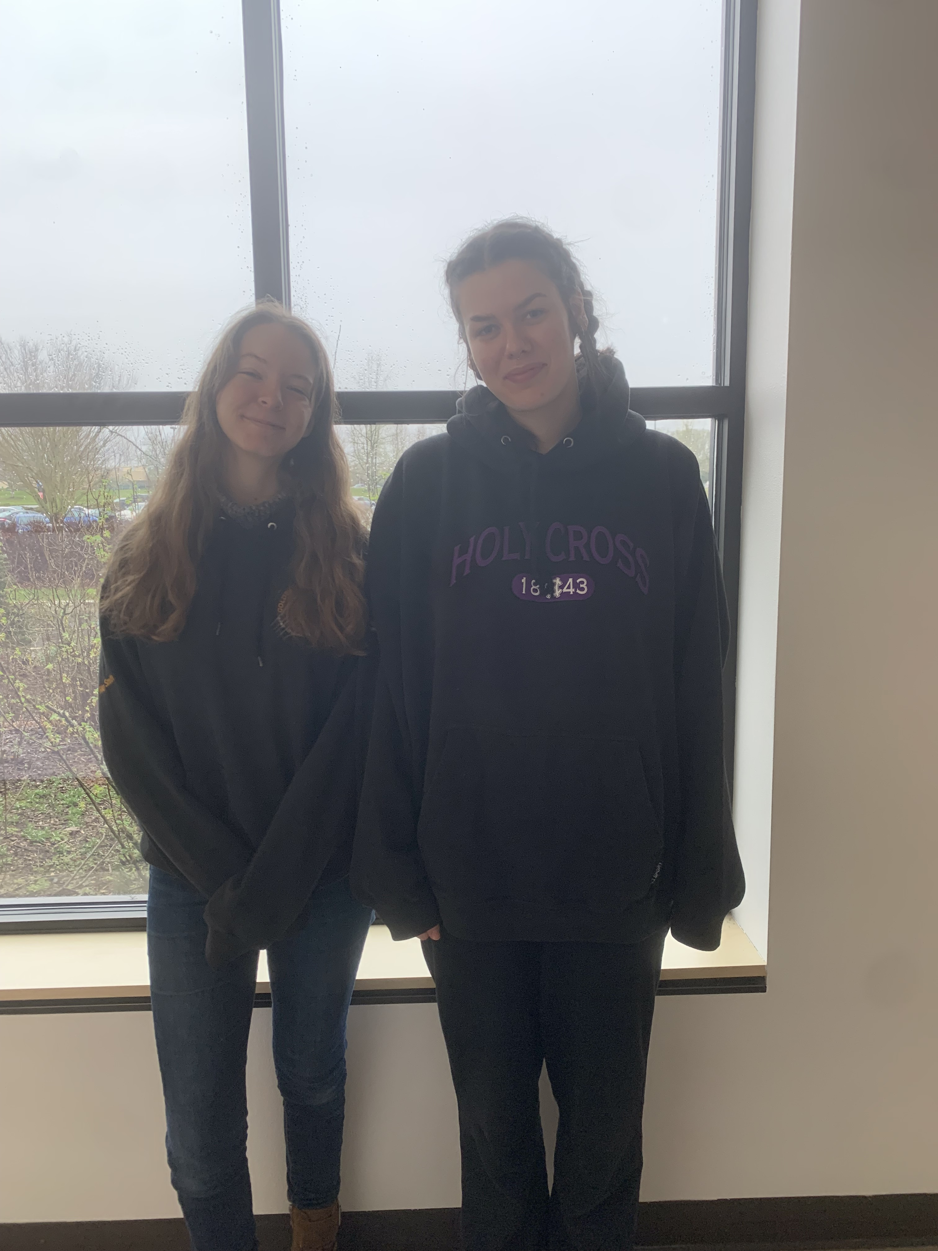
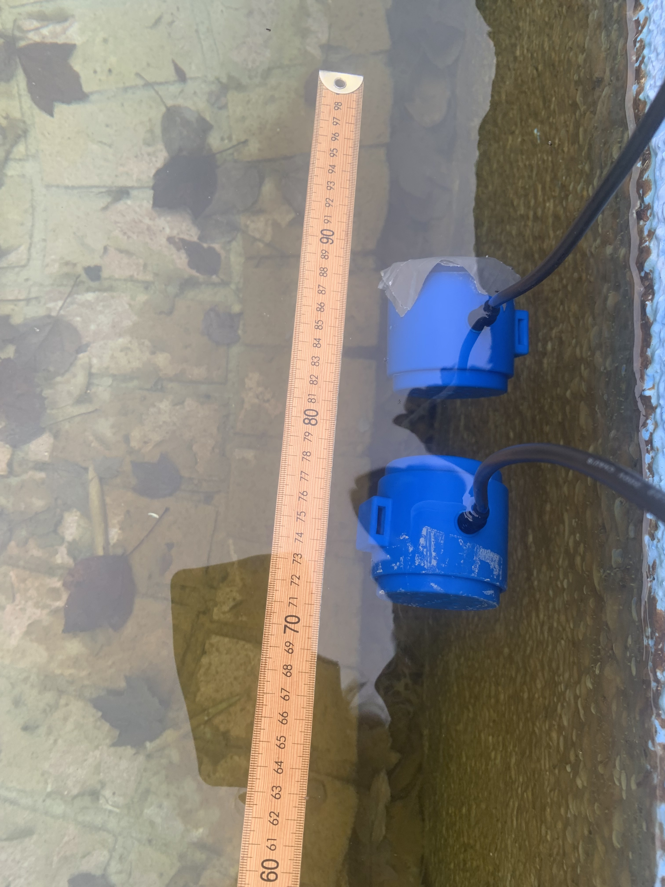
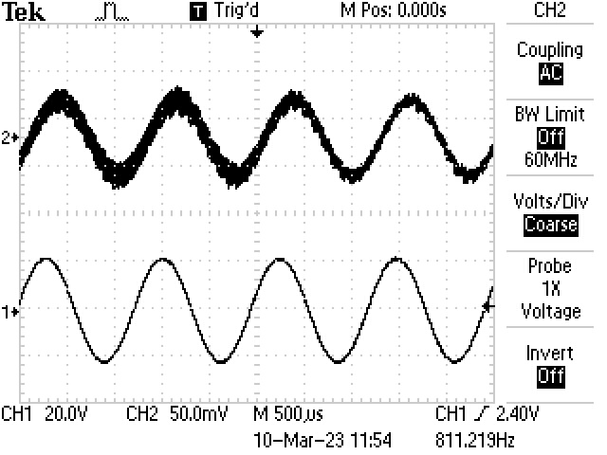
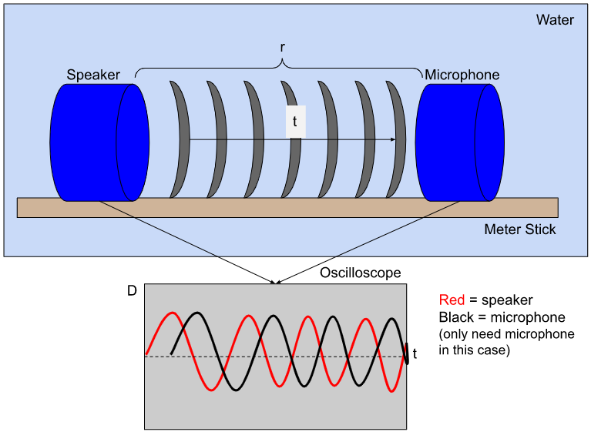
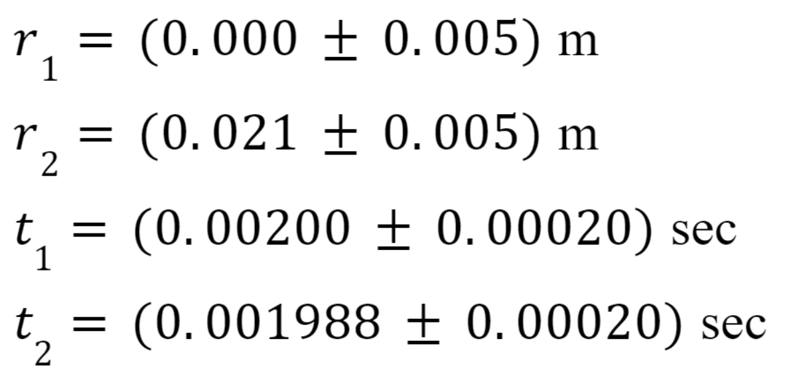
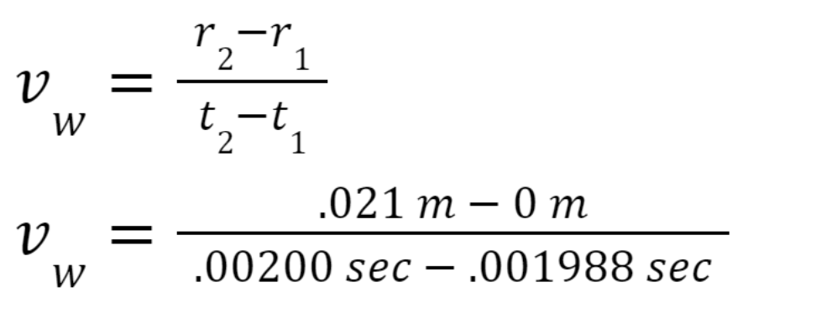
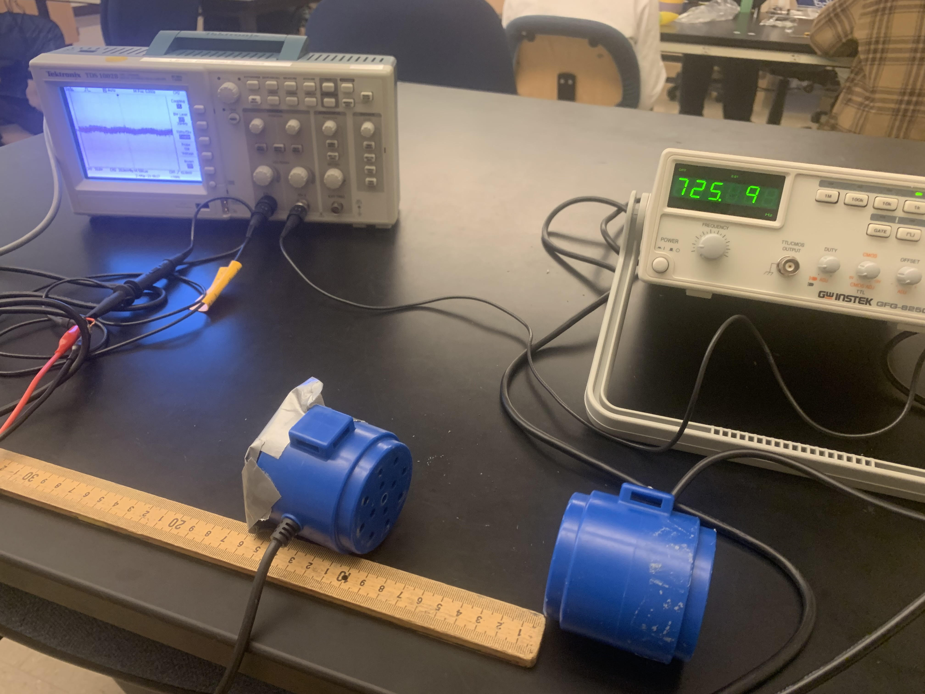
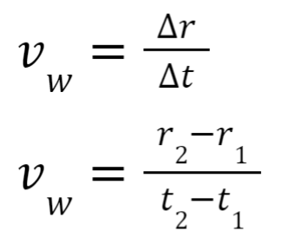

Speed of Sound
Underwater
Riley Smith, Luna Alvarez
Physics 212 Winter 2023
METHODOLOGY
We measured the distance between the two speakers with a meter stick under the water of the pond at Linn-Benton Community College, lined up with the center of the speakers. This will give us the two different distances needed to find velocity.
We then used the data from the oscilloscope (connected to the speaker and the microphone) to measure the distance between the two known points on the graph to find the change in time from each distance.
The point that we chose was when the wave was at maximum displacement. This will give us the two known times (the length of time difference that it takes to travel the differences in distance) to find the velocity. Standard propagation of error was used to find our uncertainty.
Research Question: What is the speed of sound underwater?
DATA AND ANALYSIS
WHY IS THIS IMPORTANT?
The speed of sound in water has been used in many research projects, especially those relating to ocean acoustics. Radar systems use this information to find the depth of the seafloor, which can be used to map the ocean floor. It can also be used in biological or ecological sciences, such as studying the behavior of whales.
The first experiment to find the speed of sound in water involved shooting a gun at a bell underwater, where an observer would measure when the light was seen to the time that the bell was heard through the underwater sonar. This is not dissimilar to the methods used in this project, though the current method is much more accurate and uses more advanced technologies.
Velocity is defined as the change in distance over the amount of time it took to travel the distance. If my team can measure the distance from a sound emitter to a sound receiver at two different instances, as well as the time it takes to travel this change in distance, we will be able to find the speed of sound in water!
SUPPLIES AND EQUIPMENT
Oscilloscope (Tektronix TDS1002B)
Function Generator (GW INSTEK GFG-8250A)
2 Underwater Speakers (Daravoc MA001)
Meter stick
Pool
FORMULA:
CONCLUSION:
We found the speed of sound underwater to be v_{w}=(1750±293)m/s.
FUTURE RESEARCH:
Velocity of sound in different depths of water
Velocity of sound in other sound-transmittable mediums
Study of what factors (i.e. salinity, pressure, temperature, etc.) impact velocity of sound underwater
or through other mediums

