Slide 1
Chapter 25 in the Old Text Book—Modern Optics and Matter Waves
Emission Spectra
~700nm
~350nm
A
F
T
Micr
Infra-
Ultra-
X-Rays
Gamma-Rays
M
M
V
owav
red
violet
es
Sect 24.1

Slide 2
Continuous Spectra—for example from white light
Emission Spectra—from burning pure elements
Absorption Spectra—from suns, stars and clouds
~700nm
~350nm
AM
FM
TV
Microwave
Infra-red
Ultra-
violet
X-Rays
Gamma-Rays

Slide 3

Absorption and Emission Spectra were discovered long before an explanation of them was developed.
In 1885, Johann Balmer found by experiment that the four wavelengths in the visible spectrum of hydrogen could be represented by the formula:
Where n = 3,4,5,6

Slide 4
Once it became possible to detect IR and UV radiation, other spectral series were soon discovered.
All of them fit the formula to the left.
Lyman discovered a “series” where m = 1.
Balmer had m = 2.
Paschen measured m = 3.

Slide 5
Another discovery was made when bouncing X-ray’s off a crystal (1895).
d
Sect 24.2

Slide 6
One of the last great debates before we entered the era of modern physics concerned itself if the nature of light.
For millennia people had studied the properties of light.
S. had used the principle of least distance to explain the reflection of light.
θ_{i}
θ_{r}
H. had used the principle of least action to explain refraction

Slide 7
A question that had not been answered was:
What is light made out of?
There were two main camps that had separate ideas on how to go about answering this question:
Light is made out of particles.
Light is made out of waves.

Slide 8
A strong proponent of the wave theory of light was the French engineer Augustin Fresnel. In 1819, Fresnel submitted a paper on his theories to the French Academy of Sciences. One of the members of the Academy did some calculations using Fresnel’s approach because they theory would lead to the “absurd” prediction that the shadow of an opaque sphere should have a bright spot at its center.
During the conference, Fresnel was put to public ridicule for his ideas. They planned a sarcastic coup de grace by shining a flashlight on a sphere and looking for a central bright spot...

Slide 9
They found one.

Slide 10
Electron orbit the nucleus.
Protons and Neutrons reside in the nucleus of the atom.

Slide 11
Bohr’s Model of the Atom
Electron orbit the nucleus.
Protons and Neutrons reside in the nucleus of the atom.

Slide 12
For a long time people had wondering if a beam of light consisted of particles or waves.
Around the turn of the century, it became clear that light traveled in the form of a wave. (This is a model that would have to be later revised a bit).
The next logical question then might be: What are electron, neutrons and protons? Are they waves or particles?

Slide 13
At the turn of the century, the dominant model of an atom viewed the atom as a miniature version of a solar system:
Protons and Neutrons reside in the nucleus of the atom.
Electron orbit the nucleus.
A densely packed positively charged nucleus is orbited by a system of negatively charged satellites.

Slide 14
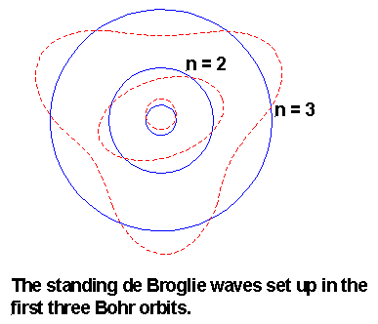
It turns out, that an electron can be treated as a wave.

Slide 15
Schrödinger’s Equation

Slide 16
This model of the atom nicely explains many phenomena.
For example: Line Spectra

Slide 17
As you heat up an atom, all the electrons absorb the heat and thus gain Kinetic Energy.
This moves the electrons out to higher orbitals.

Slide 18
Over time, (usually just milliseconds or less), the electrons fall back down into the lower states.
As they do this, they are losing their Kinetic Energy.
The Kinetic Energy is emitted as a photon.

Slide 19
As electrons are allowed only in certain orbitals, they can only fall certain, well defined “distances”.
This gives the us the well defined spectral lines that we saw in lab yesterday.

Slide 20
So, both light and matter have both wave and particle aspects to them. Let’s see what this means.

Slide 21
A photon is a particle of light when using the particle-like description of light.
The photon model of light has three basic ideas:
1) Light consists of discrete, massless particles called photons. A photon travel in a vacuum at 3.00·10⁸ m/s.
Each photon has an energy of E = hf where h = 6.63·10⁻³⁴J·s. h is called Planck’s Constant.
The superposition of a large number of photons has the characteristics of a classical light wave.

Slide 22
620 nm is around the wavelength of our red laser from last week.
a) What is the energy of a red photon?
First, we need to find the frequency of a red photon.
The energy is then E = hf
=3.21·10⁻¹⁹ J

Slide 23
b) Our lasers had a power output of about 100mW. How many photons were being shot out of the laser every minute?
If the energy of each photon is E=3.21·10⁻¹⁹ J/photon then:

Slide 24
Matter also has particle and wave aspects to it.
A person named deBroglie postulated that the wavelength of a piece of matter would be:

Slide 25
Some deBroglie wavelengths:
An electron in an old-fashioned television tube
m_{e}=9.11·10⁻³¹kg v = 4.35·10⁶ m/s ➔ λ = 0.167 nm
A smoke particle
m_{s}=10⁻¹⁸kg v = 0.001 m/s ➔ λ = 0.7 pm
Greg running
m_{g}=60kg v = 3.0 m/s ➔ λ = 3.7·10⁻³⁶ m

Slide 26
Go to “What the bleep…”
http://www.youtube.com/watch?v=3_BzTMeV4HI
Warning, the above movie has a few serious “issues” – the clip we are watching is mostly very good however.

Slide 27

Let’s place a wire coil around each door. We are going to look for induced currents in each coil.
This will tell us exactly which door each electron passes through.
Notes:
27

Slide 28
Let’s place a wire coil around each door. We are going to look for induced currents in each coil.
This will tell us exactly which door each electron passes through.

Slide 29
Like a sound wave, a matter wave can be “trapped” in a box.
L

Slide 30
Question 1:
Find the energy states of an electron trapped in a one dimensional box of length L.
Question 2:
Let’s find some energy levels for an electron trapped in a box of length 15nm.
Question 3:
How much energy does it take to boost the electron from the 1st energy state to the 5th state?
Question 4:
What wavelength of light will cause the electron to boost from the 1st to the the 5th energy state? For light E=hf → E = hc/λ → λ = hc/E.

Slide 31
Energy levels for an electron in a 1 micrometer long box.
Electron Harmonic Mode | KE needed for this Wave State
1 | 2.68063E-22 | Joules
2 | 1.07225E-21 | Joules
3 | 2.41256E-21 | Joules
4 | 4.289E-21 | Joules |  | E needed to go from E1 to E5 is going to be
5 | 6.70156E-21 | Joules |  | E5-E1 | 6.4335E-21 | Joules
6 | 9.65025E-21 | Joules
7 | 1.31351E-20 | Joules
8 | 1.7156E-20 | Joules |  | The wavelength of light equal to 6.4*10^-21 Joules
 |  |  |  | is equal to hc/E
 |  |  |  | 3.09163E-05 | meters

Slide 33
What is superfluidity?
Well, it’s a substance existing as a Bose-Einstein Condensate, of course.

Slide 34
Matter comes in two different types:
Fermions
Bosons
Fermions are called spin-half particles. Common fermions are electrons and protons.
Bosons are called integer spin particles. Common bosons are photons (light) and He-4 atoms.

Slide 35
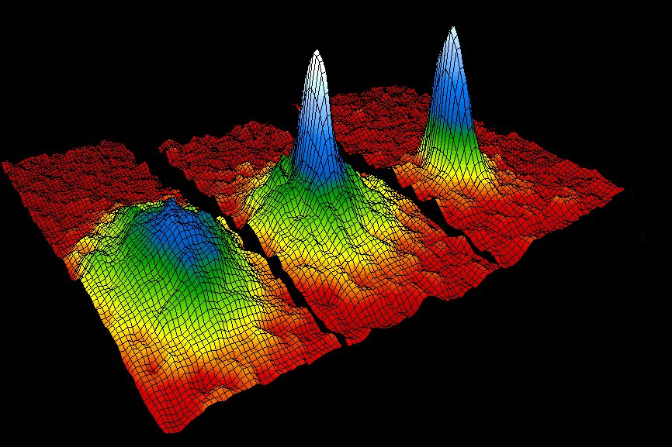
Fermions obey something called “The Pauli Exclusion Principle”. This simply means that two fermions can’t be in the same place at the same time.
Bosons don’t obey the Pauli Exclusion Principle. This means that two Bosons can be in the same place at the same time.
http://www.colorado.edu/physics/2000/bec/

Slide 36
The 1996 Nobel Prize was given to the group who first created a group bosons all exiting in the place at the same time--this was call a Bose-Einstein Condensate, or a Super-Fluid.

Slide 37
Chapter 12: We discussed rotational motion. A test question on this chapter will require to you either:
Use conservation of energy or
Use conservation of angular momentum or
Use Torque_{net} = Iα
Chapter 13: We learned that F = GmM/r²
To solve any problem in Chapter 13 you need to either use the force equation along with a picture and FBD to find what you’re looking for - or – you might need to use Conservation of Energy in which case using the work theorum from Ph 211 you find that U_{g} = -GmM/r
Chapter 14: SHM – in this chapter a FBD needs to reduce down an equation that has a form of a = -ω²s. Once you get this equation you know that the equation of motion is s(t) = Acos(ωt + φ_{o})

Slide 38
Chapter 15: Fluids
Archimedes’ Principles Bernoulli’s Principles
Chapter 20: Traveling Waves – D(x,t) = A sin(kx - ωt + φ_{o})
Chapter 21: Standing Waves – the first thing you do is draw three pictures (of the lowest three modes)
Chapter 22: Diffraction – the equation for single slits, double slits, aperatures, diffraction gratings will be given.
There could also be a problem about an interferometer.
Chapter 23 and 24 Optical devices. You should to use Lens’ Law and the Thin Lens Law to solve problems. You should be able to draw ray diagrams of convex lenses, concave lenses, refracting telescopes and reflecting telescopes.
Chapter 25: You should be able to calculate the wave length of a piece of matter. You should be able to shoot a piece of matter through double slit or diffraction grating. And you should be able stick a piece of matter in a box and find the energy levels.
Doppler Effect
Damped SHM

Slide 39
Please go here and complete the survey.
http://www.physics.oregonstate.edu/OR_IDsurvey

