Slide 1
Chapter 33 – Wave Optics
Topics that we will cover:
Light Diffraction with:
Double Slits
Diffraction Gratings
Single Slits
Circular Apertures
Huygens Principle
Interferometry
Note that this is Chapter 22 in the 3rd edition of Knight.

Slide 2
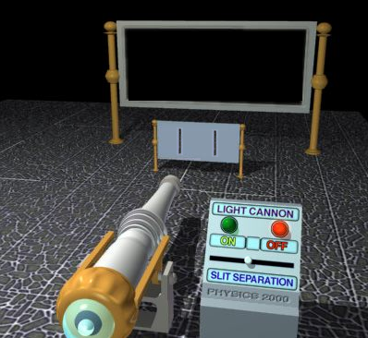
Let’s start with a general question. If you were to shine a big laser beam through the two slits as shown below, what sort of pattern would you expect on the wall behind the two-slit screen?
http://www.colorado.edu/physics/2000/index.pl

Slide 3
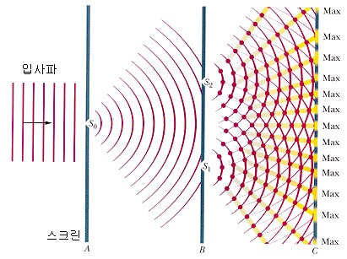
Interference of Light
http://vsg.quasihome.com/interfer.htm

Slide 4
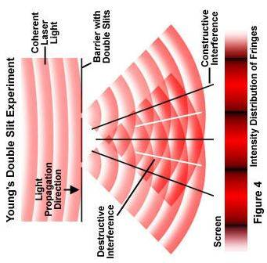
A slightly different representation of double-slit interference.

Slide 5
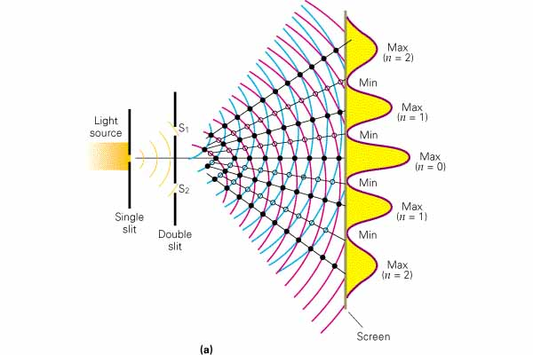
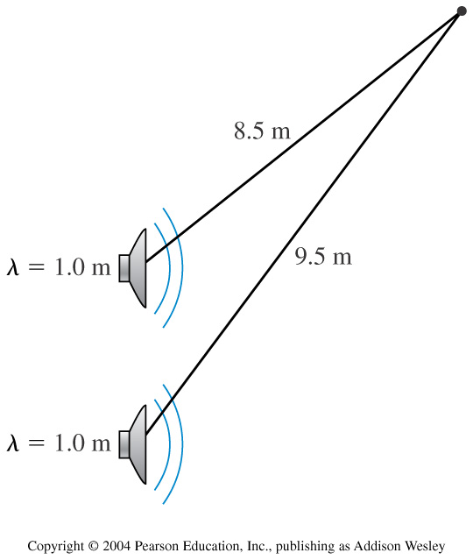
How can we figure out where the bright spots on the screen are? Well, we’ve already begun to do this when we looked at interference in sound waves.
Remember this problem.

Slide 6
r₂
y = Ltanθ
r₁
d
.
L
What needs to happen is that
Δr = mλ

Slide 7
y = Ltanθ
d
Now, the next step might sound a bit cheesy, but it works.
For light, the distance d << L thus we get:
.
L
Δr = dsinθ

Slide 8
So, back to the light case, we get:
mλ = dsinθ
But wait, θ is usually very small in this case, thus we get to use our friend THE SMALL ANGLE APPROXIMATION!
Thus, we get mλ = dθ or
Where m = 0,1,2,3,…

Slide 9
Where m = 0,1,2,3,…
Usually, θ is difficult to measure, so we measure the distance from the central max to the fringe (y) instead.

Slide 10
http://vsg.quasihome.com/interfer.htm

Slide 11
Quick Quiz Questions
tells us where the bright lines are, create a formula that will tell us where the dark lines are.
If

Slide 12
Meanwhile, if you were real industrious, you could find out how bright each bright spot is:

Slide 13
If you shine a green laser (with λ=5000Å) through two slits that are 3μm apart how far apart with the first fringe be from the central bright fringe if the double-slit screen is 20cm away from the projection screen?

Slide 14
Diffraction Gratings work similarly to a double-slit, except this time we can’t use the small angle approximation.
dsinθ_{m} = mλ
y_{m} = Ltanθ_{m}
y₂
y₁
d
L

Slide 15
Light from a sodium lamp passes through a diffraction grating having 1000 slits per mm. The interference pattern is viewed on a screen 1.000 meters behind the grating.
Two bright yellow fringes are visible 72.88cm and 73.00cm from the central maximum. What are the wavelengths of these two fringes?
dsinθ_{m} = mλ
y_{m} = Ltanθ_{m}

Slide 16
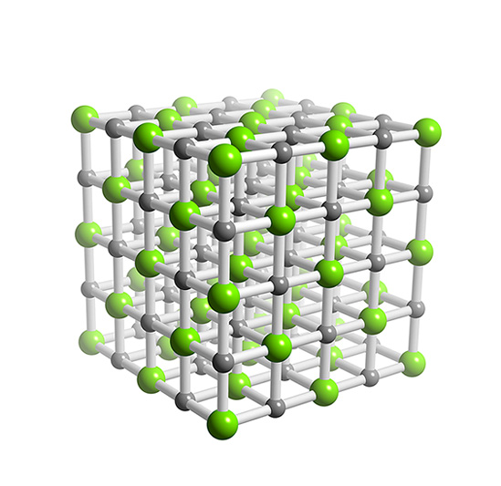
Sample Problem:
An x-ray source is bounced of a salt crystal. The x-ray pattern created on a screen a distance L above the crystal looks like this.
What is the spacing between x-ray dots on a screen place 1.0 meter away from the top surface of the salt crystal if a) λ=10nm b) λ=.10nm
Cl⁻ spacing is 0.4 nm

Slide 17
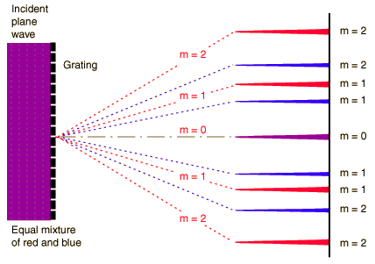
What if we try to pass multiple colors through a diffraction grating?

Slide 18
For a single slit system:
Where y_{m} is the position of the m’th dark fringe
p = 1,2,3,…
a = the width of a single slit
Thus, the width of the central bright spot must be:

Slide 19
Single Slit Diffraction
http://www.phys.hawaii.edu/~teb/optics/java/slitdiffr/

Slide 20
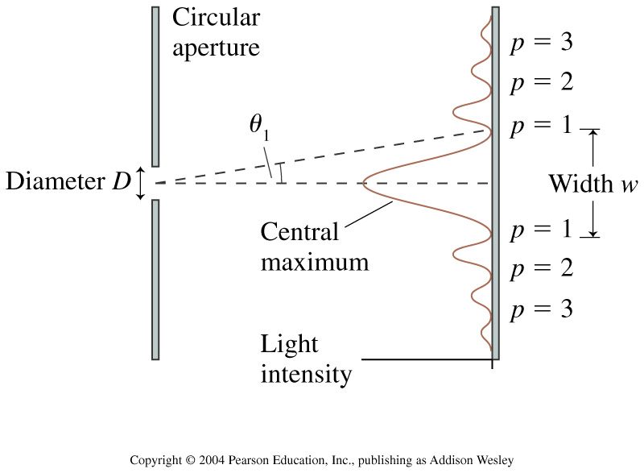
Circular Aperture Diffraction

Slide 21
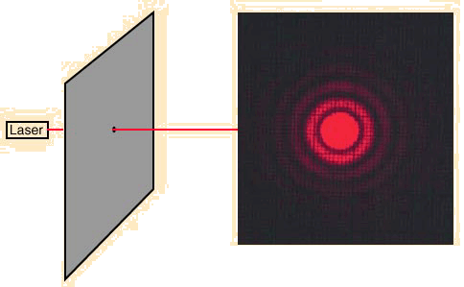
Circular Aperture Diffraction
The position of the first dark fringe is:

Slide 22
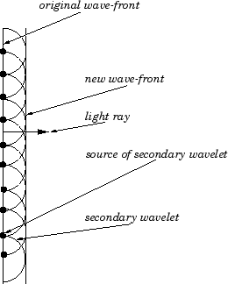
Huygens’ Principle:
Each point on a wave front is the source of a spherical “wavelet” that spreads out at the wave speed.
At a later time, the shape of the wave front is the line tangent to all the wavelets.
Huygens’ Principle for reflection and refraction
http://www.walter-fendt.de/ph14e/huygenspr.htm

Slide 23
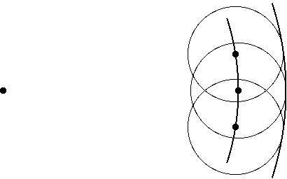
Huygens’ Principle can also nicely explain the wavefront you see when you drop a pebble in a pool of water.

Slide 24
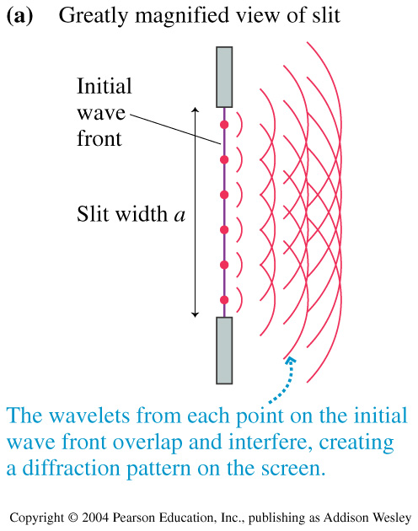
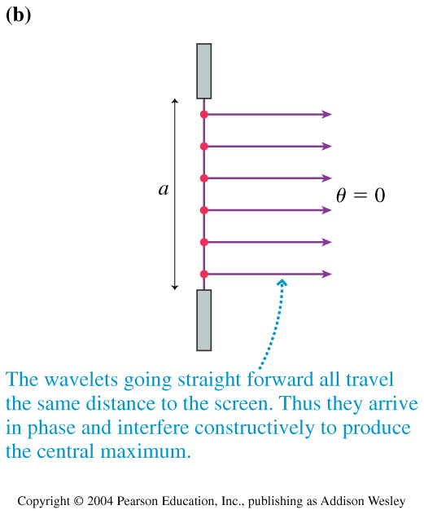
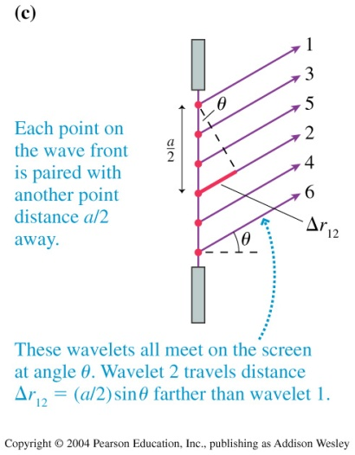

Slide 25


Slide 26
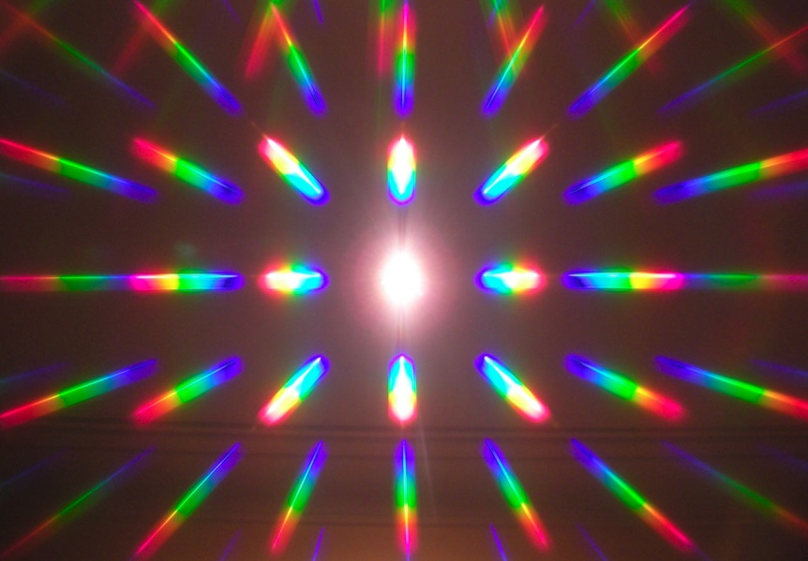
Sample Problem 22.43
White light (400-700nm) incident on a 600line/mm diffraction grating produces rainbows of diffracted light .
What is the width of the first-order rainbow on a screen 2.0 m behind the grating?

Slide 27
Interferometery
http://www.youtube.com/watch?v=8QUhgYaxWao&feature=related
http://www.youtube.com/watch?v=7aR8HmWjHs4&feature=related

Slide 28
Chapter 33 – Wave Optics
Topics that we covered:
Light Diffraction with:
Double Slits
Diffraction Gratings
Single Slits
Circular Apertures
Huygens Principle
Interferometry

Slide 29
Chapter 33 – Wave Optics
Optics is the study of Light
There are two main way to describe light:
The Ray Model (or the particle model)
The Photon Model (or the wave model)

