Slide 1

Chapter 17 Goals:
Understand the principle of superposition.
Be able to calculate the resonant frequencies in physical situations that create standing waves. For example: strings, musical instruments, laser cavities, microwave ovens.
Understand the principle of interference. Be able to perform calculations for thin-film interference and two-speaker interference.
Understand the concepts of “beats”.

Slide 2
Draw a picture for any resonant frequency except for the fundamental.
In this picture:
Somehow show what the molecules are doing.
Show where there flame will be and won’t be.

Slide 3
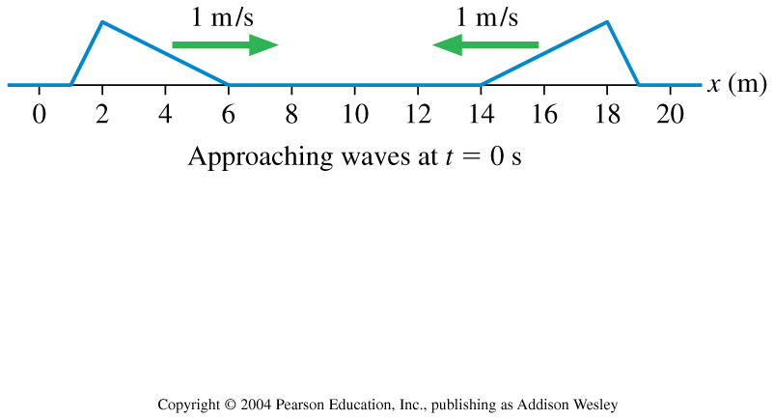
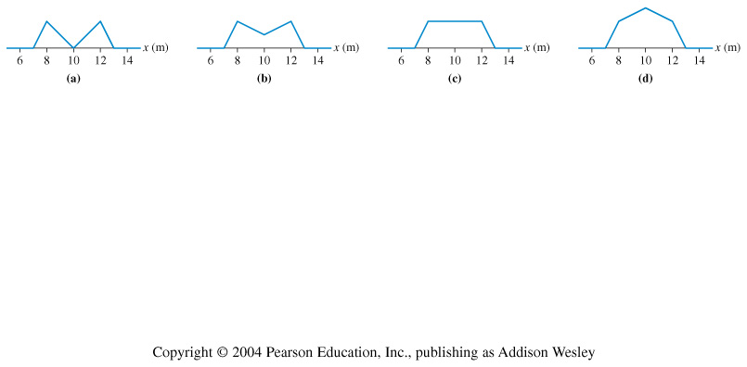
Two pulses on a string approach each other at speeds of 1 m/s. What is the shape of the string at t = 6 s?
(1) (2) (3) (4)
Notes:
IG20.1

Slide 4
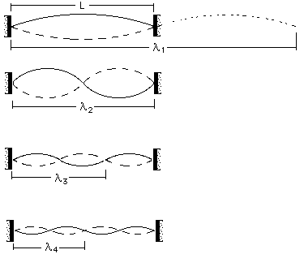
Let’s try to derive the resonant frequencies of a guitar string.

Slide 5
Find the resonant frequencies for a “closed-open” string (i.e. a string fixed at one point and oscillating freely at the other side).

Slide 6
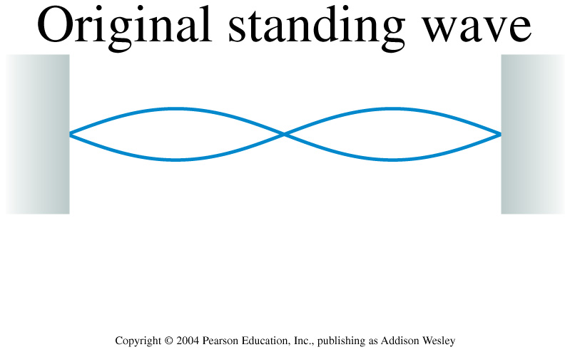
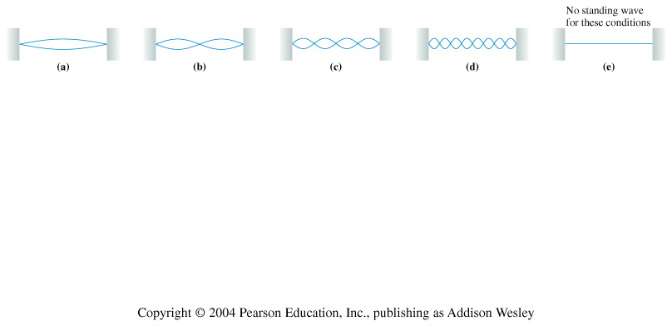
A standing wave on a string vibrates as shown at the top. Suppose the tension is quadrupled while the frequency and the length of the string are held constant. Which standing wave pattern is produced?
(1) (2) (3) (4) (5)
Notes:
STT21.2

Slide 7
An open-open tube of air supports standing waves at frequencies of 300 Hz and 400 Hz, and at no frequencies between these two. The second harmonic of this tube has frequency
1. 800 Hz.
2. 600 Hz.
3. 400 Hz.
4. 200 Hz.
5. 100 Hz.
Notes:
STT21.3

Slide 8
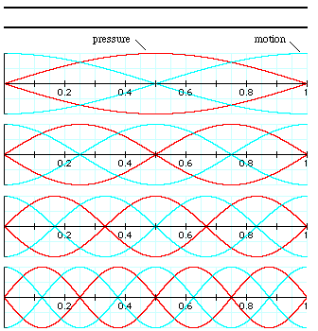
Standing waves in an open-ended tube

Slide 9

An open-open tube of air supports standing waves at frequencies of 300 Hz and 400 Hz, and at no frequencies between these two. The second harmonic of this tube has frequency
1. 800 Hz.
2. 600 Hz.
3. 400 Hz.
4. 200 Hz.
5. 100 Hz.
Notes:
STT21.3

Slide 10
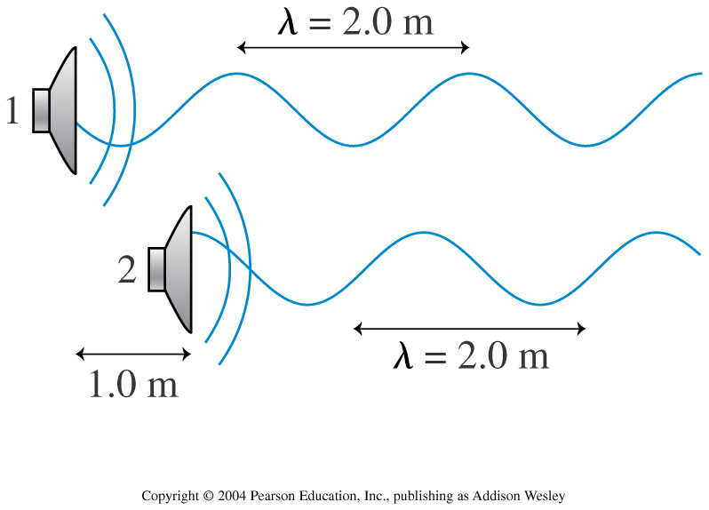
Two loudspeakers emit waves with λ = 2.0 m. Speaker 2 is 1.0 m in front of speaker 1. What, if anything, must be done to cause constructive interference between the two waves?
1. Move speaker 1 backward (to the left) 0.5 m.
2. Move speaker 1 backward (to the left) 1.0 m.
3. Move speaker 1 forward (to the right) 1.0 m.
4. Move speaker 1 forward (to the right) 0.5 m.
5. Nothing. The situation shown already causes constructive interference.
Notes:
STT21.4

Slide 11
Two loudspeakers emit waves with λ = 2.0 m. Speaker 2 is 1.0 m in front of speaker 1. What, if anything, must be done to cause constructive interference between the two waves?
1. Move speaker 1 backward (to the left) 0.5 m.
2. Move speaker 1 backward (to the left) 1.0 m.
3. Move speaker 1 forward (to the right) 1.0 m.
4. Move speaker 1 forward (to the right) 0.5 m.
5. Nothing. The situation shown already causes constructive interference.
Notes:
STT21.4

Slide 12
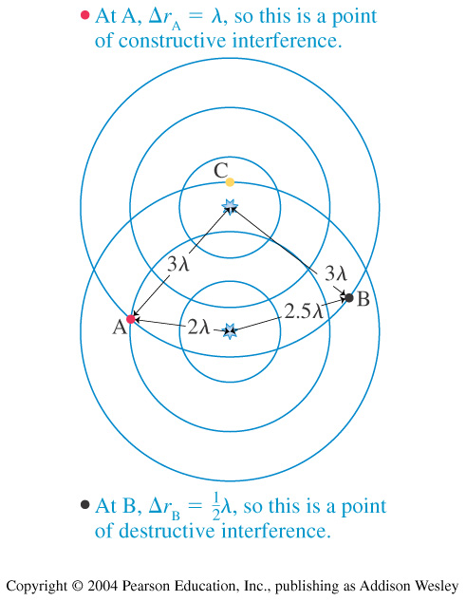
The interference at point C in the figure at the right is
1. maximum constructive.
2. destructive, but not perfect.
3. constructive, but less than maximum.
4. there is no interference at point C.
5. perfect destructive.
Notes:
STT21.5

Slide 13
The interference at point C in the figure at the right is
1. maximum constructive.
2. destructive, but not perfect.
3. constructive, but less than maximum.
4. there is no interference at point C.
5. perfect destructive.
Notes:
STT21.5

Slide 14
Reflected waves at boundaries
http://www.kettering.edu/~drussell/Demos/reflect/reflect.html

Slide 15
Reflected waves at boundaries
Thus:
When a wave hits a “hard” boundary, the reflected wave is inverted (i.e. shifted 180º).
When a wave hits a “soft” boundary, the reflected wave is not inverted.
The transmitted wave always keeps the same phase as the incoming wave.

Slide 16
Thin films

Slide 17
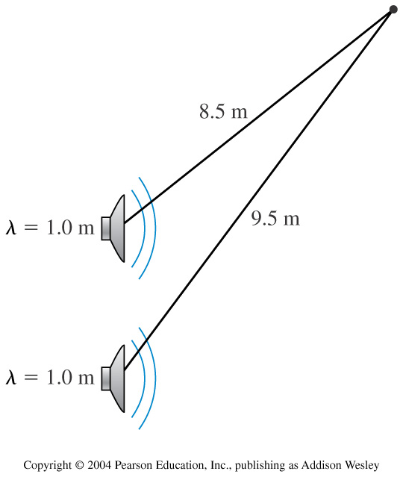
These two loudspeakers are in phase. They emit equal-amplitude sound waves with a wavelength of 1.0 m. At the point indicated, is the interference maximum constructive, perfect destructive or something in between?
1. maximum constructive
2. perfect destructive
3. something in between
Notes:
STT21.6

Slide 18
These two loudspeakers are in phase. They emit equal-amplitude sound waves with a wavelength of 1.0 m. At the point indicated, is the interference maximum constructive, perfect destructive or something in between?
1. maximum constructive
2. perfect destructive
3. something in between
Notes:
STT21.6

Slide 19
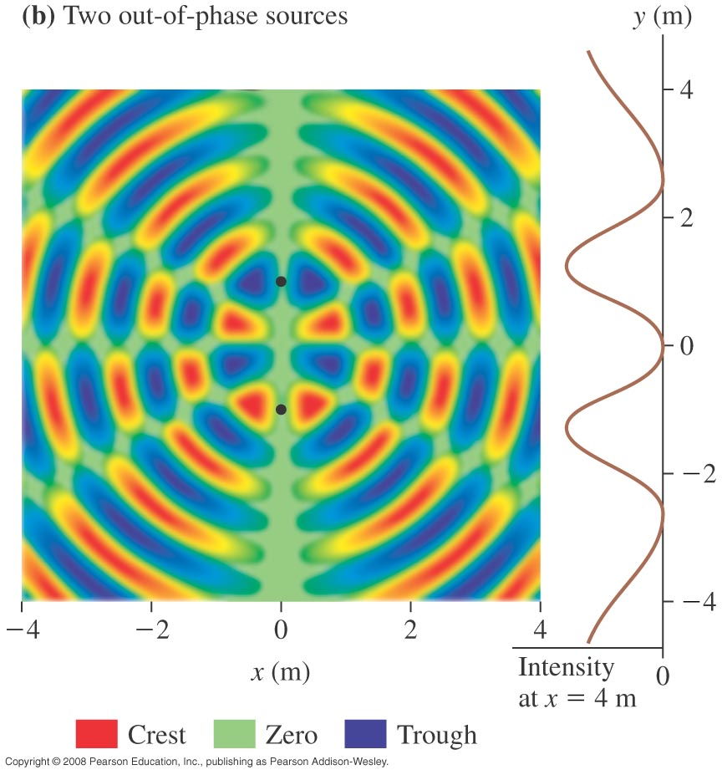
Question 21.71

Slide 20
You hear three beats per second when two sound tones are generated. The frequency of one tone is known to be 610 Hz. The frequency of the other is
1. 604 Hz.
2. 607 Hz.
3. 613 Hz.
4. 616 Hz.
5. Either 2 or 3.
Notes:
STT21.7

Slide 21
You hear three beats per second when two sound tones are generated. The frequency of one tone is known to be 610 Hz. The frequency of the other is
1. 604 Hz.
2. 607 Hz.
3. 613 Hz.
4. 616 Hz.
5. Either 2 or 3.
Notes:
STT21.7

Slide 22
From Chapter 21 you should be able to:
Find the resonant frequencies of situations such as: a wave on a string; waves in open-open, closed-closed and open-closed tubes.
You show be know what happened to w a wave at a boundary between two media.
You should be able to investigate the properties of thin-films… i.e. you should be able to find the thickness of a thin film needed to maximum transmission and reflection.
You should know that f_{beat} = the difference between the two interfering frequencies.

Slide 23
Addition of waves:
http://www.kettering.edu/~drussell/Demos/superposition/superposition.html
Standing Waves:
http://www.glenbrook.k12.il.us/GBSSCI/PHYS/mmedia/waves/swf.html
Beats: http://ionaphysics.org/ntnujava/waveSuperposition/waveSuperposition.html
http://www.colorado.edu/physics/2000/schroedinger/
http://www.hazelwood.k12.mo.us/~grichert/sciweb/waves.htm
http://id.mind.net/~zona/mstm/physics/waves/interference/waveInterference1/WaveInterference1.html

