Slide 1
Chapter 16
Traveling Waves
Three types of waves:
Mechanical Waves
Electromagnetic Waves
Matter Waves
20.1

Slide 2
Two Types of Wave Motion:
Transverse Waves
Longitudinal Waves
http://www.youtube.com/watch?v=CswoSQC_NX0

Slide 3
One-Dimensional Waves
The speed of a wave in a stretched string can be found by:
Where T is the Tension in the string and μ is the linear density (in kg/m) of the string.
20.2

Slide 4
The frequency, wavelength and speed of a wave are related by:

Slide 5
A certain rope has a mass of 0.70 kg and length 8.0 meters.
If you pull on this rope with a force of 20N, at what speed will a wave travel down this rope?

Slide 6
In our previous wave equation, we are looking at just the time component of a wave.
When we send a single wave down a string, it’s pretty easy to see that the wave is non-repeating over space and thus we have to create a new wave equation that will not only tell us what is happening in time, but also what is happening in space.
is the angular frequency
k is the “wave number”
D(x,t) thus gives you the distance your string has displaced itself from its equilibrium position at position x and time t.
20.3

Slide 7
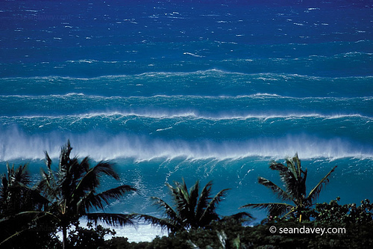
Snapshot Graphs vs. History Graphs
A wave-train of beautifully sinusoidal surfing waves are hitting the beach once every 10 seconds. The speed of these waves are 5m/s and the trough to peak amplitude is 8 meters.
Create a “Snapshot Graph” of what these waves look like as a function from distance from the beach.
In Coastal Surf Report the eight meters is called the “Swell” and the 10 seconds in called the period.

Slide 8
Snapshot Graphs vs. History Graphs
A wave-train of beautifully sinusoidal surfing waves are hitting the beach once every 10 seconds. The speed of these waves are 5m/s and the trough to peak amplitude is 8 meters.
A buoy is anchored 500 meters from the shore. Create a “History Graph” of what the buoy experiences.
In Coastal Surf Report the eight meters is called the “Swell” and the 10 seconds in called the period.

Slide 9
Snapshot Graphs vs. History Graphs
Find the numerical values for k, ω and φ_{o}.
(Do not look up equations in your book!)
In Coastal Surf Report the eight meters is called the “Swell” and the 10 seconds in called the period.

Slide 10
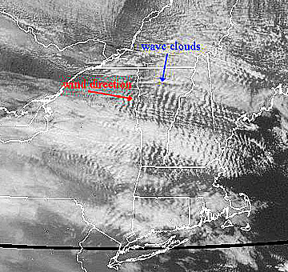
Atmospheric Wave Train

Slide 11

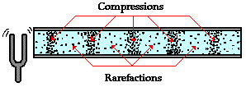
λ

Slide 12
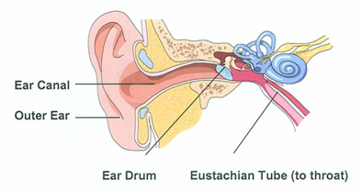
Snapshot Graphs vs. History Graphs
A tuning 523Hz tuning fork is emitting sound. Create a history graph of your eardrum. Sound travels at 331 m/s at STP.
(Your eardrum experiences a total displacement of 1mm)

Slide 13
Which of the following actions would make a pulse travel faster down a stretched string?
1. Move your hand up and down more quickly as you generate the pulse.
2. Move your hand up and down a larger distance as you generate the pulse.
3. Use a heavier string of the same length, under the same tension.
4. Use a lighter string of the same length, under the same tension.
5. Use a longer string of the same thickness, density and tension.
Notes:
STT20.2

Slide 14

Which of the following actions would make a pulse travel faster down a stretched string?
1. Move your hand up and down more quickly as you generate the pulse.
2. Move your hand up and down a larger distance as you generate the pulse.
3. Use a heavier string of the same length, under the same tension.
4. Use a lighter string of the same length, under the same tension.
5. Use a longer string of the same thickness, density and tension.
Notes:
STT20.2

Slide 15
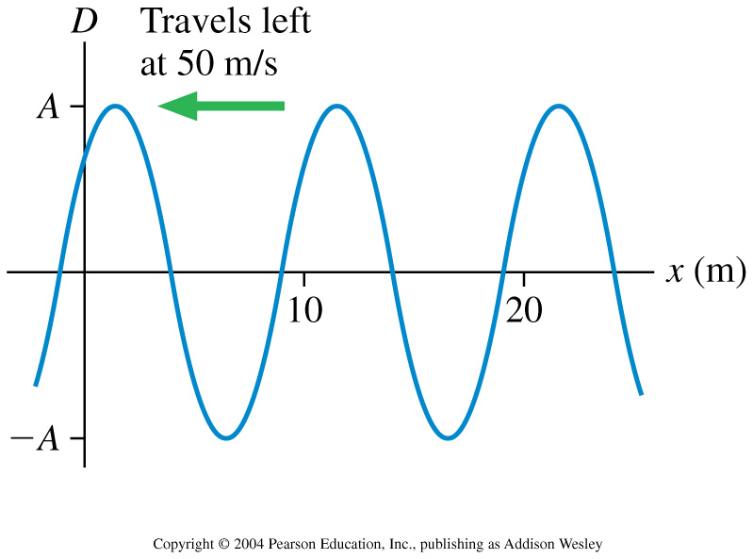
What is the frequency of this traveling wave?
1. 10 Hz
2. 5 Hz
3. 2 Hz
4. 0.2 Hz
5. 0.1 Hz
Notes:
STT20.3

Slide 16
What is the frequency of this traveling wave?
1. 10 Hz
2. 5 Hz
3. 2 Hz
4. 0.2 Hz
5. 0.1 Hz
Notes:
STT20.3

Slide 17
What is the phase difference between the crest of a wave and the adjacent trough?
1. 0
2. π /4
3. π /2
4. 3 π /2
5. π
Notes:
STT20.4

Slide 18
What is the phase difference between the crest of a wave and the adjacent trough?
1. 0
2. π /4
3. π /2
4. 3 π /2
5. π
Notes:
STT20.4

Slide 19
Let’s use the concept of phase shift to find the speed of sound in this room.

Slide 20
Electromagnetic Radiation Travels in a vacuum at a speed of c = 299,792,458 m/s
(yes, this is a proper reporting of sig. figs)
The speed of light is actually used as the current definition of the SI unit of length.
http://www.mel.nist.gov/div821/museum/timeline.htm

Slide 21
Wavelength =
~700nm
~350nm
AM
FM
TV
Microwaves
Infra-red
Ultra-
violet
X-Rays
Gamma-
Rays
Low Energy
Long Wavelength
Low Frequency
High Energy
Small Wavelength
High Frequency

Slide 22
Doppler Effect
Doppler Effect for Sounds for an:
Approaching source or approaching observer
or Receding source or a receding observer
Doppler Effect for Light for a:
Receding source
or Approaching source

Slide 23
You have a satellite orbiting the moon with an orbital radius of 2000km. The satellite is transmitting a carrier signal at 154.41MHz.
Within what range will your receiver have to be able to detect a signal if you want to be able to receive the satellite’s carrier frequency?
Earth’s moon mass =7.36·10²²kg.

Slide 24
Power and Intensity
Let’s look at how intensity changes for a laser vs. a “spherical point-source radiator”

Slide 25
Sample Problem:
A satellite orbiting the Earth measures the Intensity of the light from the sun to be 1400 Watts/m².
How much light energy does the sun put out per year?
How much mass does the sun lose per year?

Slide 26
Summary of Topics covered in Chp. 20
Traveling waves can be modeled via the equation:
k is the ‘wave number’ and is related to the traveling wave’s wavelength (λ).
ω is the ‘angular frequency’ and is related to the “normal” frequency (f) or the period.
Phi is the phase constant.
And A the amplitude.
“x” is where you are looking and “t” is when you are looking
“D” is the diplacement of the particle in question
The Doppler Effect:
Power and Intensity:

Slide 27
Sample Problems:
Traveling Waves and the wave equation:
Things you should be able to do for this type of problem:
be able to model a traveling wave using an equation
be able to determine physical quantities such as: v, f, k, and ω
Be able to draw snap shot and history representations of a traveling wave.
20.53
A wave on a string is described by D(x,t) = (3.0cm)sin[2π(x/(2.4m) + t/(0.20s) +1)], where x is in m and t is in sec.
In What direction is this wave traveling?
What are the wave speed, the frequency, and the wave number?
At t = 0.50 sec, what is the displacement of the string at 0.20m?

Slide 28
Sample Problems:
The Doppler Effect
A bat emits a sonic “ping” at a frequency of 50.0kHz. The bat is flying toward North at 3.0 m/s. You are bicycling South at 9.0 m/s. What frequency does the bat hear in the reflection off you of its “ping”?

Slide 29
Sample Problems:
Light and intensity
A “perfect” 100 mW laser makes 1.0cm diameter dot on a wall 10 meters away. What is the intensity in that dot?
A “perfect” 100 W light bulb emits light equally in all directions. What is the light intensity at a point on a wall 10 meters away from the bulb?

Slide 30
Sample problem:
Calculate the power output of our sun.
Given: A satellite in Earth’s Orbit receives 1407Watts/m² (this is called the ‘solar constant’).

