Slide 1
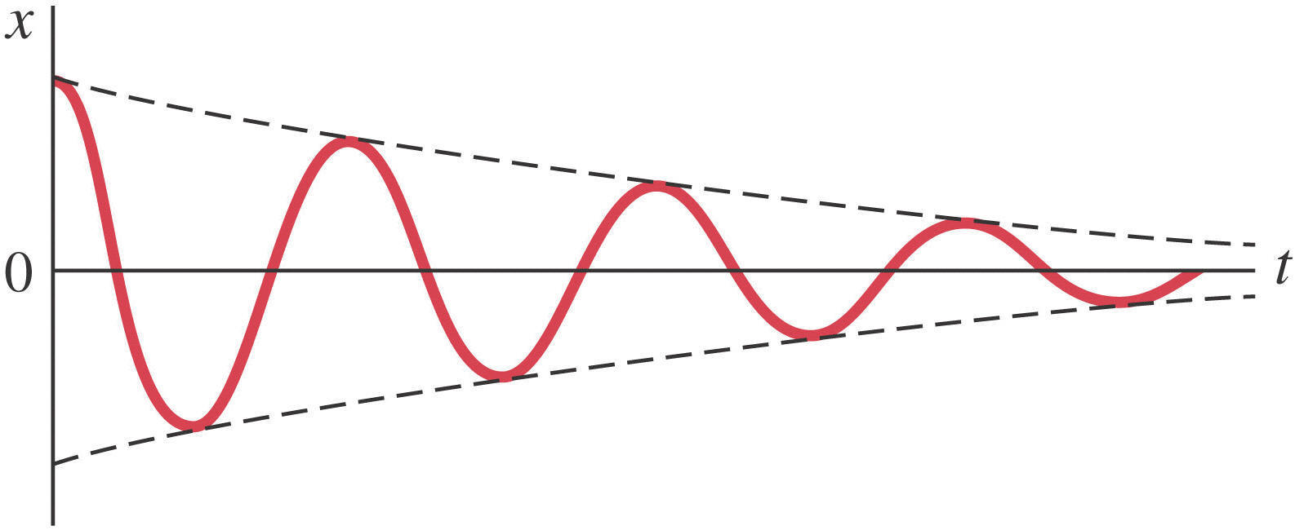
Chapter 14 – Oscillations
Or
All of Ph 211 That Wiggles

Slide 2
Some Definitions
This is the amplitude A
One cycle takes time T.
T is then called the period.
Note: τ is also often used for period.
14.1

Slide 3
Some Definitions
A
T
The frequency f is then
Units of frequency are then s⁻¹≡Hz
Since a “cycle” happens during each period, Hz can be thought of as being “cycles per second”.

Slide 4
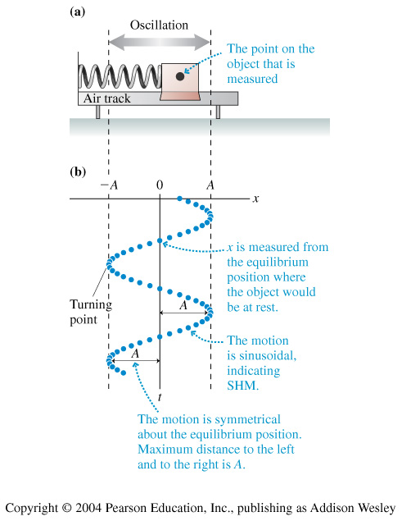
Imagine an object undergoing periodic motion such as this spring/mass system.
This system is undergoing Simple Harmonic Motion.

Slide 5
Some Definitions
The equation of motion for an object undergoing Simple Harmonic Motion is:
x(t) = Acos(ωt)
where ω is the angular frequency of oscillation.

Slide 6
Some Definitions
x(t) = Acos(ωt)
A = Amplitude
ω = angular frequency

Slide 7
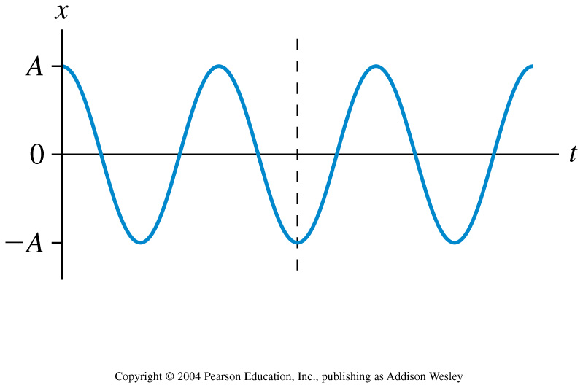
This is the position graph of a mass on a spring. What can you say about the velocity at the instant indicated by the dotted line?
1. Velocity is positive.
2. Velocity is negative
3. Velocity is zero;
Notes:
STT14.4

Slide 8
With your neighbor, on your white-board, find the velocity vs. time and acceleration vs. time equations of motion for a simple harmonic oscillator who position equation looks like this.
x(t) = Acos(ωt)

Slide 9
An object moves with simple harmonic motion. If the amplitude and the period are both doubled, the object’s maximum speed is
1. quartered.
2. halved.
3. quadrupled.
4. doubled.
5. unchanged.
Notes:
STT14.1

Slide 10
It turns out that this equation doesn’t quite give us enough information. x(t) = Acos(ωt)
Our equation of motion needs to be able to include an “initial position”. In order to do this, we add the concept of a “phase constant” and we get:
x(t) = Acos(ωt + φ_{o})
http://www.emu.edu.tr/mugp101/PHYSLETS/physletprob/ncat/oscillations/s_circle.htm
14.2

Slide 11

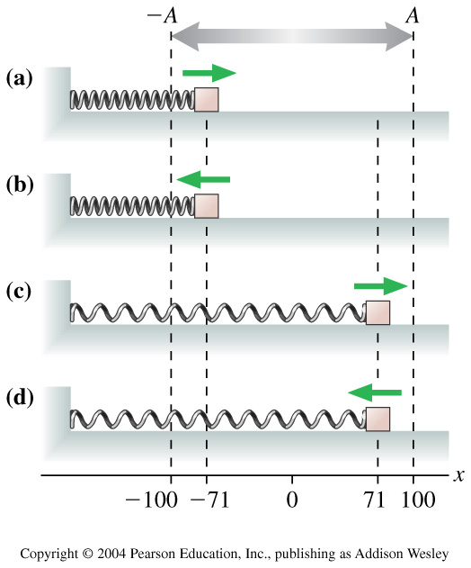
The figure shows four oscillators at t = 0. Which one has the phase constant
1) a
2) b
3) c
4) d
Notes:
STT14.2

Slide 12
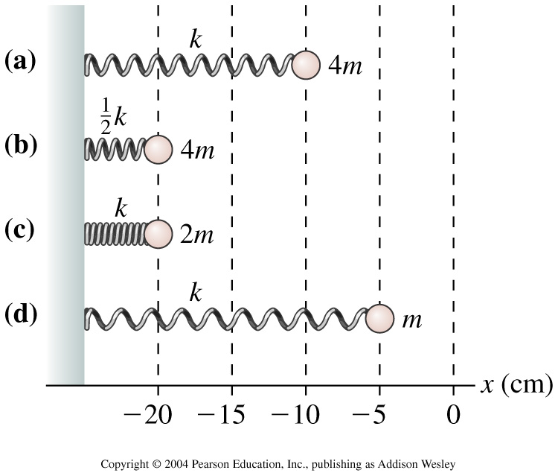
Four springs have been compressed from their equilibrium position at x = 0 cm. When released, they will start to oscillate. Rank in order, from highest to lowest, the maximum speeds of the oscillators.
1. c > b > a = d
2. c > b > a > d
3. d > a > b > c
4. a = d > b > c
5. b > c > a = d
Notes:
STT14.3

Slide 13
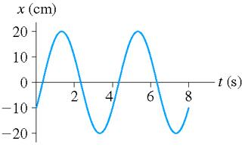
For the oscillation shown below, what is:
(a) amplitude (in cm),
(b) frequency (in Hz and ang. Freq.) and
(c) phase constant (in radians and degrees) .
a. 20cm
b. f=.25Hz
ω=2πf
c. φ_{o} = -(2/3)π = -120°

Slide 14

Four springs have been compressed from their equilibrium position at x = 0 cm. When released, they will start to oscillate. Rank in order, from highest to lowest, the maximum speeds of the oscillators.
1. c > b > a = d
2. c > b > a > d
3. d > a > b > c
4. a = d > b > c
5. b > c > a = d
Notes:
STT14.3

Slide 15
This is the position graph of a mass on a spring. What can you say about the velocity and the force at the instant indicated by the dotted line?
1. Velocity is positive; force is to the right.
2. Velocity is negative; force is to the left.
3. Velocity is negative; force is to the right.
4. Velocity is zero; force is to the right.
5. Velocity is zero; force is to the left.
Notes:
STT14.4

Slide 16
This is the position graph of a mass on a spring. What can you say about the velocity and the force at the instant indicated by the dotted line?
1. Velocity is positive; force is to the right.
2. Velocity is negative; force is to the left.
3. Velocity is negative; force is to the right.
4. Velocity is zero; force is to the right.
5. Velocity is zero; force is to the left.
Notes:
STT14.4

Slide 17
Let’s take a look at the oscillation equations again:
If we take a look at the position equation and the acceleration equation, we see that:
You are going to see equations of this type EVERYWHERE!

Slide 18
Simple Harmonic Motion
Hooke’s Law: F = -kx
Some things we’ve found about springs:
The spring exerts a force when it is compresses as well as when it is stretched.
The restoring force is always opposed to the direction of stretching or compressing.
When we draw a free body diagram for this we get:
ma_{x} = -kx
m

Slide 19
Simple Harmonic Motion
Hooke’s Law: ma_{x} = -kx
m
But this is the thing you are going to see EVERYWHERE!
So, you get to say, “Ah-ha! I know that this system oscillates with a frequency of:
!!!”

Slide 20
Let’s try another system which, from experience, we know undergoes oscillation:
θ
A Simple Pendulum consists of a mass connected to (massless) string or stick.
In this case, our pendulum has a length L with a bob of mass m.

Slide 21
Let’s draw a free body diagram of this:
r
T
Looking at just the tangential components of the forces, we find that:
θ
t
θ
s
W
Now, in this case, θ = s/L
We’re tempted to say “Ah ha!”

Slide 22
r
T
t
Shucks, they don’t match!
θ
W
But with a physics/math trick, we can make it work!

Slide 23
The SMALL ANGLE TRICK:
For small values of θ
Ah-ha! That is the form of an equation that we were looking for.

Slide 24
Looking at our equation of motion for the pendulum we can now find the ω of our system:
For a simple pendulum.

Slide 25
Let’s try a sample problem:
Let’s drill a hole through the center of the Earth in order to make a transportation system.

Slide 26

The “Spherical Shell Theorem”
Outside a shell of matter, the gravity from the mass acts as if all the mass is concentrated inside the shell.
Inside a shell of matter, there is no net gravitational attraction from the shell outside of your position.

Slide 27
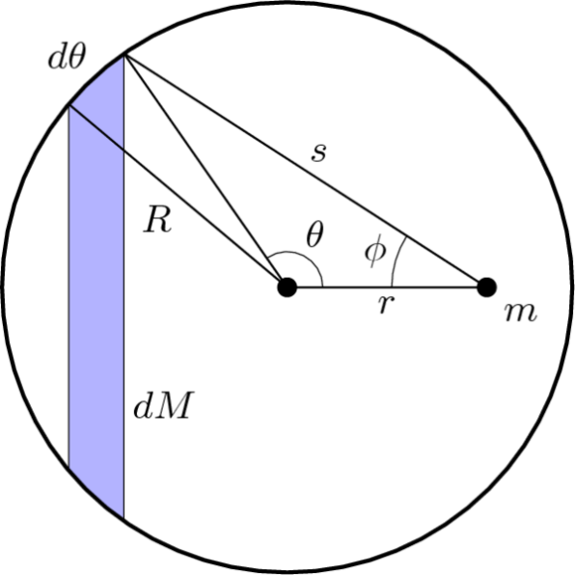
How to prove the “Spherical Shell Theorem”:
In order to find the gravitation of the whole sphere, we need to integrate all the individual parts of the sphere.
After some calculation you can see shell exerts no net force on particles anywhere within its volume. Reasoning intuitively using inverse-square law, the few pieces of the shell that are close to m exert a large force, but there aren't many of them. By contrast, there are many pieces of the shell far from m but their force contribution is smaller.
We could write this as:
for r > R
for r < R

Slide 28
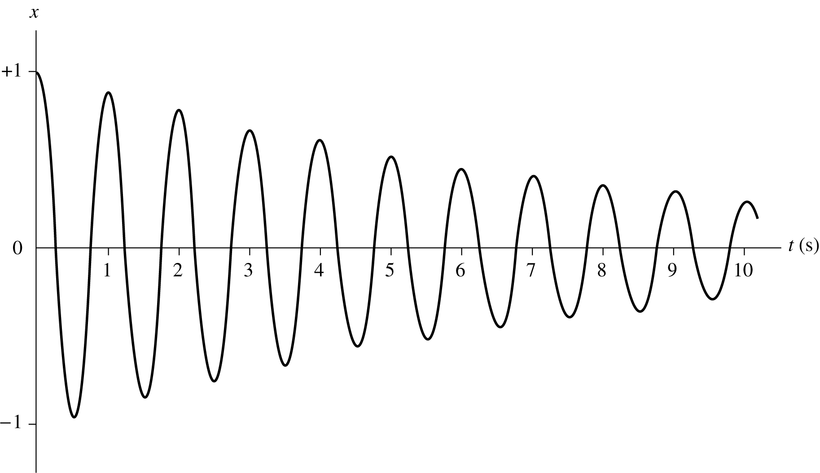
In a frictionless environment, our pendulum would keep running forever. However, as we well know, friction will eventually effect our system greatly.
An oscillation system that takes into account friction is called a “Damped Oscillator”.

Slide 29
The motion of a damped oscillator has some common characteristics:
This is the wave envelope
e^{-t/2τ}
This is the amplitude
A
sin(ωt+φ)
This is the oscillatory part of the function.

Slide 30
When we combine all together we get:
This is the wave envelope
e^{-t/2τ}
This is the amplitude
A
sin(ωt+φ)
The equation of motion for a damped simple harmonic oscillator.
This is the oscillatory part of the function.
x(t) = Ae^{-t/2τ}sin(ωt+φ)

Slide 31
Question:
An oscillating spring system is found to have decreased it’s amplitude by 50% after 25 seconds.
By what amount will the amplitude have decreased by 50 seconds?
To answer this question, we need to only look at the damping term of the position equation:
x(t)=A₀e^{-t/2τ}
We are looking for when x(t) = ½ A_{o}.
We will use the first piece of information to find our time constant τ.
Then, we will use that τ to find x(t) when t=50seconds.

Slide 32
Simple Harmonic Motion
Hooke’s Law: F = kx
The symbol k is called the “Spring Constant”.
It has the units of N/m.
The bigger the value of k the more stiff the spring.
M
M
M

Slide 33
Exercise 1
When a 5 kg mass is suspended from a spring, the spring stretches by 15cm. What is the spring constant?
M
M

Slide 34
Exercise 2:
A 16 N force is applied to a spring whose constant is 100 N/m.
How much does the spring stretch?

Slide 35
Now, we know from experience in the situation to the left, if we pull on the weight and then let go, the system oscillates.
If this motion is graphed (i.e. a displacement vs. time graph), the graph is sinusoidal.
This is an example of Simple Harmonic Motion.
M

Slide 36
Summary of Chp. 15:
1) Definitions: T (sec), f (1/sec defined as Hz), and ω (rad/sec).
2) and 3) and 4) For an object undergoing Simple Harmonic Motion the equation of motion has the most general form of:
x(t) = A e^{-kt}cos(ωt + φ_{o}) (1/(2τ) = κ)

