Slide 1
Chapter 15
Fluids and Elasticity
Or
All of Ph 211Under Pressure

Slide 2
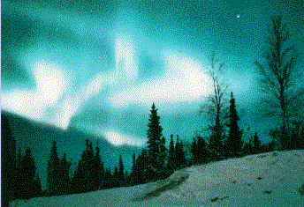
A fluid is a substance that flows.
Types of Fluids:
Liquids
Gases
Plasmas
Bose and Fermi Fluids
Section 15.1

Slide 3
A liquid has a well defined surface.
Molecules are about as close to each other as they can get.
Liquids are incompressible.
Liquids
In a gas, molecules rarely in contact with one another.
Molecules are far apart.
Gasses are compressible.
Gasses

Slide 4
Plasmas exist normally at very high temperatures so that molecules are now partially or fully ionized.
The electrons, since they are less massive, tend to move around a lot more than the more massive ion.
Each “species” in the plasma has a resonance frequency
Plasmas
These
Bose-Einstein Condensates

Slide 5
mass
volume
Density
≡
We might say that density is the compactness of a material.

Slide 6
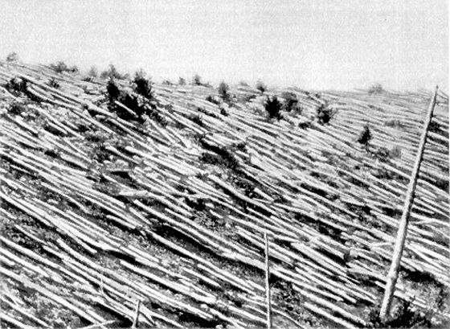
Some Densities: g/cm³
Water (at 4°C) 1.00
Ice 0.92
Wood ~0.5 - ~ 1.5
Mercury 13.6
Gold 19.0
Neutron Star ~1,000 trillion

Slide 7
PRESSURE :
force exerted over some area
FORCE
pressure =
area

Slide 8
Which Dad
looks
stressed?
Why?

Slide 9
The SI unit of Pressure is a Pascal.
Other very commonly used units:
kPa = 1000 Pa
1atm = 101,300 Pa = 101.3 kPa
Also:
Bars, Torrs, PSI’s, there’s a lot of them.

Slide 11
The Bed of Nails:
Can a person lay down on a bed of nails if the nails are homogeneously distributed with a distance of 1 inch (2.53cm) per each nail?
Can a person laying down on a bed of nails have a brick broken over their body?

Slide 12
I have checked the air pressure in the tires of my car today and found out that they are measuring a pressure of 32 PSI.
What other measurement would I need to take in order to find the weight of my car?
I find that each tire makes a “footprint” of 5 inches by 6 inches.
What is the mass of my car?

Slide 13
Atmospheric Pressure:
The average pressure at sea level on the planet Earth has been defined as 1atm.
The higher up you go in altitude, the lower the actually atmospheric pressure.
Sample Problem: Find the mass of the Earth’s atmosphere.

Slide 14
Pressure in a liquid:
The pressure you experience at a certain depth in a liquid depends upon the weight of the liquid above you.
p_{o}A
pA
mg
p_{o}A
Liquid of density ρ
Depth=d
pA=p_{o}A + mg
pA

Slide 15
pA=p_{o}A+mg
Divide through by the Area and we get
p=p_{o}+ρgd

Slide 16
Let’s try and see what the pressure at the bottom of a swimming pool is.
Osborne is 5 meters deep at the deep end.
p = p_{o}+ρgd
Remember that
1atm = 101 000 Pa

Slide 17
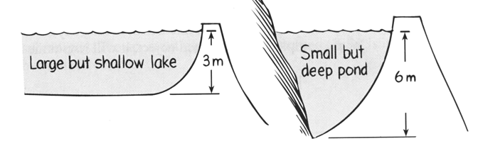
Which dam would
need to be the strongest?
Why? Because:
p = p_{o}+ρgd

Slide 18
Question: What force would the dam be experiencing due to the small but deep pond? The pond is 6 meters deep and 25 meters wide
dam
Water
d=6meters
The problem here is that the pressure upon the dam changes depending upon thus depth. Consequently, we must integrate:

Slide 19
Which rigid container will experience the greatest pressure on its bottom surface?
Why? Because:
p = p_{o}+ρgd

Slide 20
Sample Problem:
A U-shaped tube, open to the air on both ends, contains mercury. Water is poured into the left arm until the water column is 13.3cm deep.
How far upward from its initial position does the mercury in the right arm rise?

Slide 21
How would the pressure compare
if you were swimming 3 meters
deep in the Pacific Ocean?
The pressure would be greater !
WHY ??
Sea water is DENSER than water -
pressure depends on BOTH density
and depth.

Slide 22
Some cool applications:
Crushing a can
Exploding a keg
Depths at great pressure

Slide 23
Archimedes’ Gold Crown
Archimedes (287-212 BC) had been given the task of determining whether a crown made for King Kieron II was of pure gold or whether it contained some cheaper metals such as silver.
Archimedes problem was to determine the density of the crown without destroying it. He could weigh the gold, but determining its volume was a problem.
Story has it that Archimedes came to the solution while sitting in a bath tub. He immediately rushed naked through the streets shouting “Eureka, Eureka!”

Slide 24
Archimedes’ Principle:
A body immersed partially or fully in a fluid, is buoyed up by a force equal to the weight of the fluid it displaces.

Slide 25
F_{b}=ρV_{displaced}g
W=m_{boat}g

Slide 26
So, let’s say you fill your glass to the brim with water and several floating ice cubes. What happens to the level of the water as the ice melts? Does...
...the glass overflow?
...the water level go down?
...the water level remain constant?

Slide 27
Let’s now have a dirty ice cube floating in a glass of water. As the ice cube melts
...the glass overflow?
...the water level go down?
...the water level remain constant?

Slide 28
Now, we have a block of density ρ_{block}=0.6g/cm³ floating in a glass of water. If you give a quick “tap” to the block, at what frequency does it start bobbing?
F_{b}=ρV_{displaced}g
F_{net} = W- F_{b}
F_{net}= W-ρ_{water}gV_{disp}
m_{object}a = W - ρ_{water}g(Ay_{submerged})
W=m_{boat}g

Slide 29
Now, we have a block of density ρ_{block}=0.6g/cm³ floating in a glass of water. If you give a quick “tap” to the block, at what frequency does it start bobbing?
F_{b}=ρV_{displaced}g
W=m_{boat}g

Slide 30
Gauge Pressure
density x depth = wd h
pressure in the fluid only
Static Head
amount of pressure due simply
to the density of the fluid and
the depth of the fluid

Slide 31
Open Tube Manometer
P₀
P is the
unknown
pressure
P
h
A
B
Pressure B = P₀ + wd h
Pressure B = Pressure A = P

Slide 33
Which type of
pump has a
limitation on how
deep the well can be
in order to successfully
pump water?
1. The pump on the left can pump water higher.
2. The pump on the right can pump water higher.
3. Both pumps can pump equally high
4. Not enough information is given.

Slide 34
Barometer
Tube with closed end
P = 0
Filled with mercury and
inverted into a dish
of mercury
P₀
h
At sea level, the column of
mercury is
760 mm

Slide 35
Fluid Dynamics
We make four assumptions for an “ideal fluid”:
The fluid is incompressible.
The fluid is nonviscous
The fluid is undergoing laminar flow
The fluid is non-rotating

Slide 36
Conservation of Mass would require that:
V₁ = V₂
A₁ Δx₁ = A₂Δx₂
A₁(v₁Δt) = A₂(v₂Δt)
A₁v₁ = A₂v₂
This is called the “Continuity Equation”
V₂= A₂Δx₂
V₁= A₁Δx₁
We could use it to find the speed of water coming through a house pipe.

Slide 37
Question:
The water main of my new house has a radius of 1cm and I’ve discovered that the water comes out at a speed of 2.0m/s.
My sink’s pipe and faucet has a radius of ½ cm.
How fast does the water come out of my faucet? (Neglect changes in height of the pipe).
A₁v₁ = A₂v₂
πr₁²v₁=πr₂²v₂

Slide 38
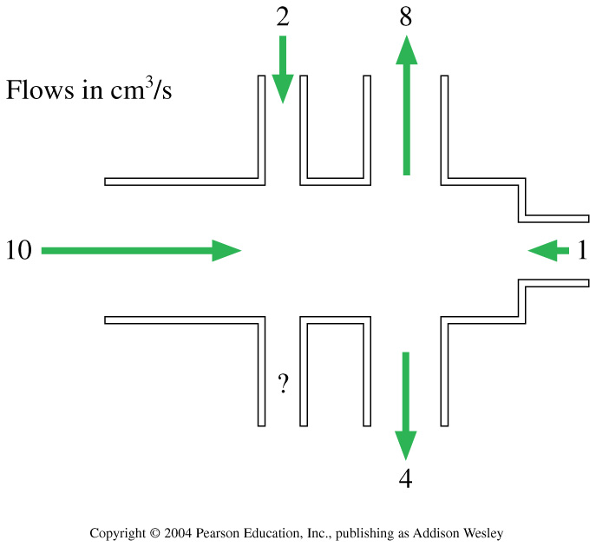
The figure shows volume flow rates (in cm³/s) for all but one tube. What is the volume flow rate through the unmarked tube? Is the flow direction in or out?
1. 1 cm³/s, out
2. 1 cm³/s, in
3. 10 cm³/s, out
4. 10 cm³/s, in
5. It depends on the relative size of the tubes.
Notes:
STT15.5

Slide 39
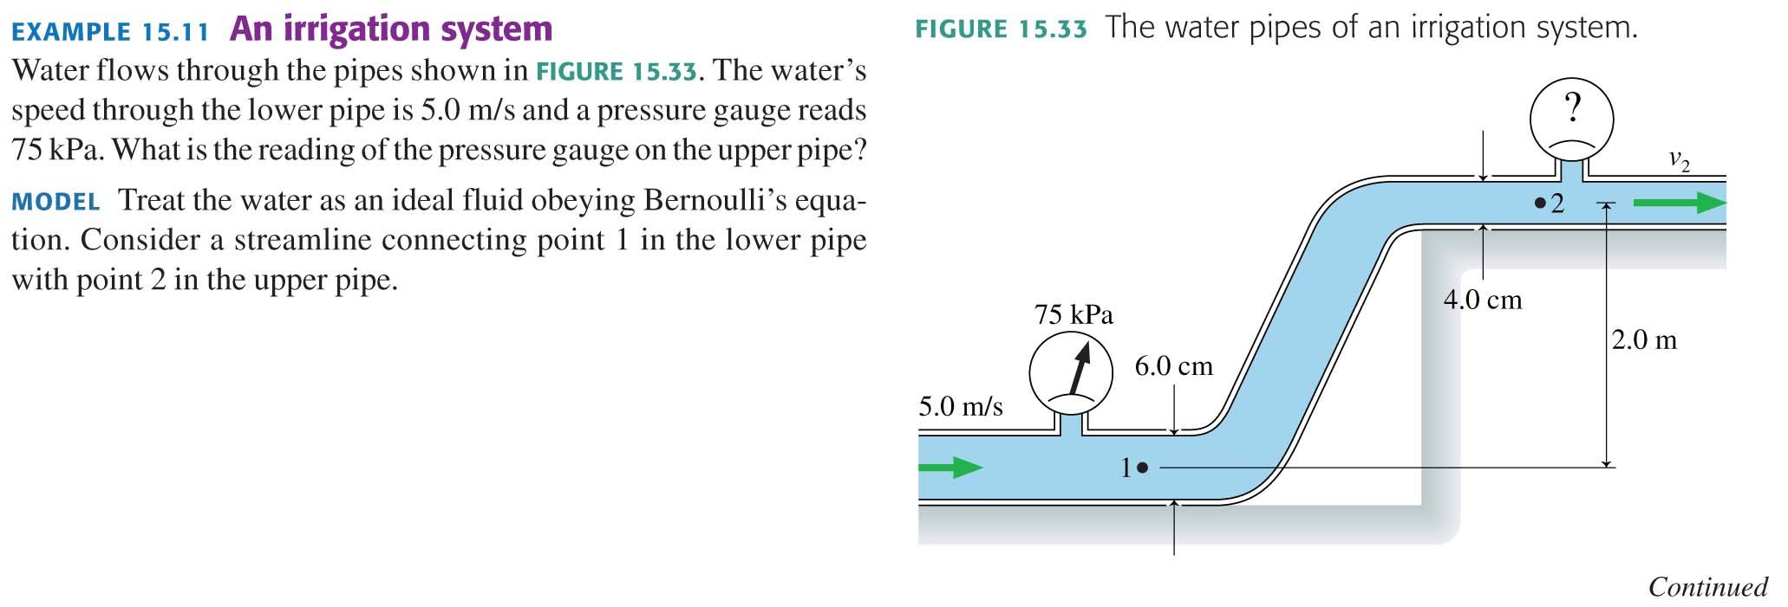
Conservation of Energy gives us another cool result known as “Bernoulli’s Law”:

Slide 40
Bernoulli’s Principle

Slide 42
Bump drafting:
http://www.youtube.com/watch?v=laERgtX3FqM&feature=related

Slide 43
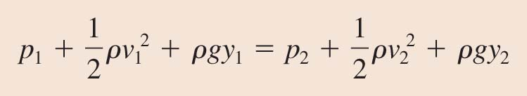
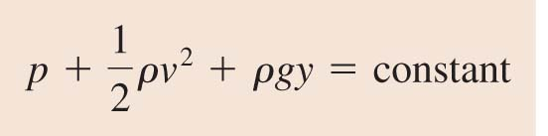
Bernoulli’s Equation
The energy equation for fluid in a flow tube is
An alternative form of Bernoulli’s equation is

Slide 44
Example Problem:

Slide 45
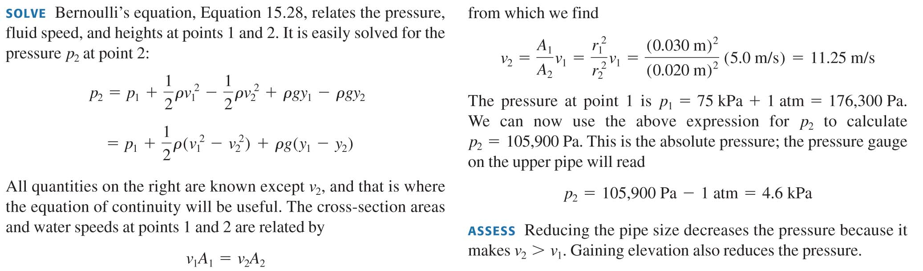

Slide 46
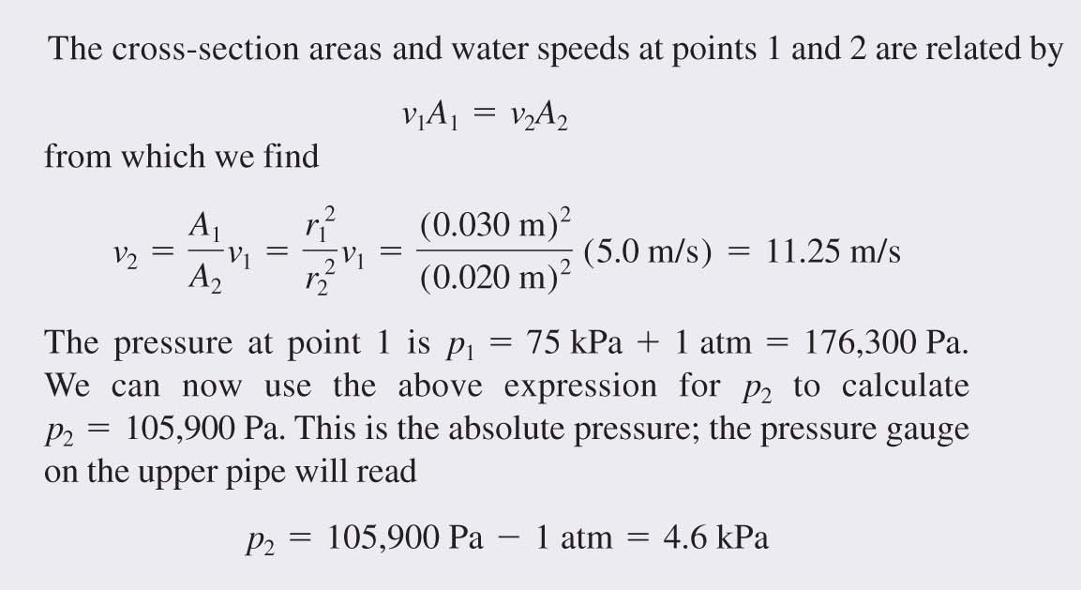

Slide 47
EXAMPLE 15.11 An irrigation system

Slide 48
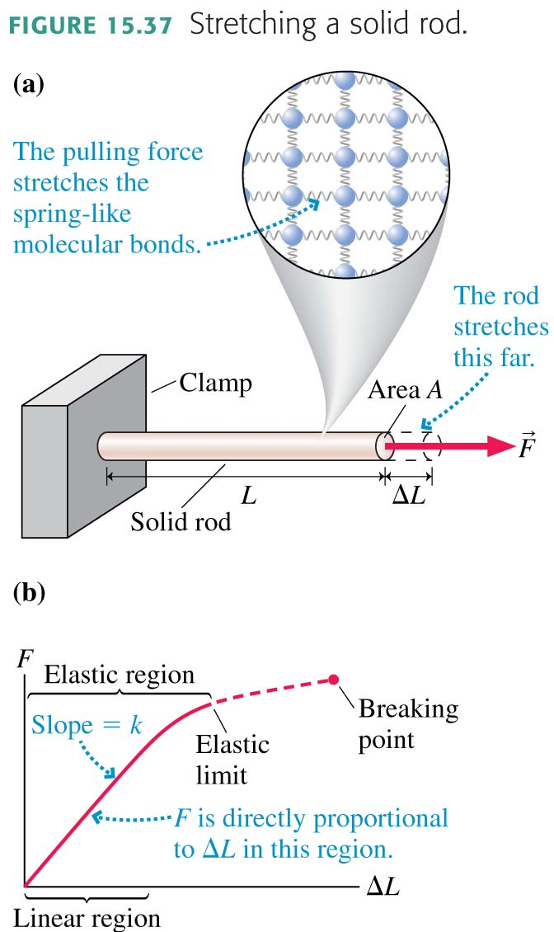
Elasticity

Slide 49
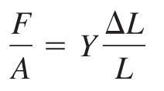

Elasticity
F/A is proportional to ΔL/L. We can write the proportionality as
The proportionality constant Y is called Young’s modulus.
The quantity F/A is called the tensile stress.
The quantity ΔL/L, the fractional increase in length, is called strain. With these definitions, we can write

Slide 50
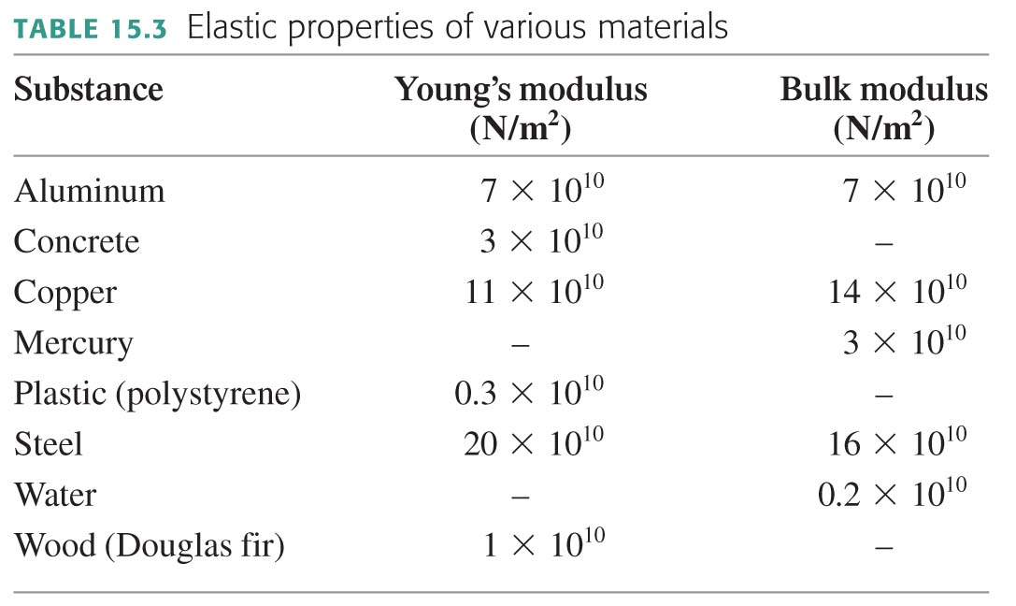

Slide 51
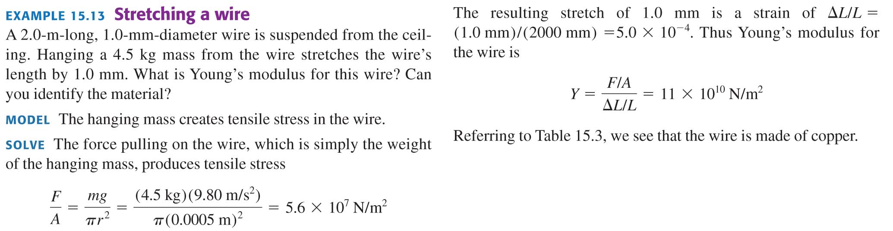
EXAMPLE 15.13 Stretching a wire
QUESTIONS:

Slide 52
EXAMPLE 15.13 Stretching a wire

Slide 53
Elasticity
Young’s Modulus
Let’s see if we can find the freq. of oscillation for Jello.
If I apply a Pressure with my finger and push in on the rod, it is going to oppose my push.
Strain
Note that P=F/A and really is not a pressure, because it is unidirectional
Young’s Modulus
Tensile Stress

Slide 54
Elasticity
Bulk Modulus
Similar to Young’s Modulus, except this is a 3D situation.

Slide 55
Elastic Deformations:
Stretching and Compression:
ΔL
L₀
F = Y A

Slide 56
A container is filled with oil and fitted on
both ends with pistons. The area of the left
piston is 44 in.²; that of the right piston
4400 in². What force must be exerted
on the left piston to keep the 4400 lb car
on the right at the same height ?
F = ? N
F = 44 lb
Car = 4400 lb
A= 44 in²
A= 4400 in²

Slide 57
A 5,000kg airplane’s two wings have a combined surface area of 20m². The airflow over the top of the airplane wings is 40% faster than the airspeed underneath. How fast does the airplane need to go before it begins to lift off the ground? (Use only first-order effects in your calculation.)

Slide 58
A U-shaped tube, open to the air on both ends, contains mercury. Water is poured into the left arm until the water column is 18.2cm deep.
How far upward from its initial position does the mercury in the right arm rise?
6.69mm

Slide 59
Concepts covered in Chp 15:
Four of the five states of matter are fluids.
Density = mass/volume
Pressure = F/A
Archimedes’ Principle = The Buoyant force upon an object partially or fully submerged is upward and equal to the weight of the fluid displaced.
Fluid Flow: Continuity Equation – since mass is conserved, the quantity of fluid entering a system has to be equal to the quantity exiting a system. Q_{in} = Q_{out} or A_{in}v_{in} = A_{out}v_{out}
Fluid Flow: Bernoulli's Equation – since energy is conserved P₀+ρgh+ ½ ρv² = constant
Elastic Properties For linear objects:
For objects as a whole objects:

