Slide 1
Chapter 12: Rotational Kinematics
Or
All of Physics 211 with a Twist

Slide 2
Motion and the Particle Model
Chp 1.2

Slide 3
Rotational Motion
Let’s look at an individual wheel on the car.
Chp 12.1

Slide 4
Chapter 12: Rotational Kinematics
Recall from last quarter, that when a particle moved with constant acceleration we found the equations of motion to:
These equations worked well for a point particle moving in 1D, 2D or 3D.
Of course, most of the universe isn’t a point particle.
Sec. 12.1

Slide 5
Fortunately, the all motion in the universe can be broken down into two types of motion:
Translational Motion
and
Rotational Motion
s
From geometry, remember that
s = rθ
r
θ

Slide 6
Rotational Motion:
≡ angular position
≡ dθ/dt ≡ angular velocity
α ≡ dω/dt = d²θ/dt²≡ angular acceleration

Slide 7
Rotational Motion
Let’s look at an individual wheel on the car.
This car is moving forward at 50 km/hr. The driver slows down at a constant rate of 2km/hr/sec.
Draw an angular position vs. time, an angular velocity vs. time and an angular acceleration of one of the wheels.
Chp 12.1

Slide 8
Later, we’re going to figure out the “cause” of an angular acceleration.
For now, simply accept that we had a constant angular acceleration slowing down our wheel in the previous problem.
Derive the “Angular Equations of Motion”.
r
θ

Slide 9
Chapter 12: Rotational Kinematics
The “new” rotational equations of motion:

Slide 10
s
From geometry, remember that:
r
θ

Slide 11
Things to do this week:
HIP 0 – this is online at minirov.info/ph212
HIP 1 – this is due Friday, download at minirov.info/ph212. Don’t forget to include a scoring rubric when you turn in.
HW1a – this is available at MasteringPhysics.com
Project: by the end of your lab period, you should know what your project is.
Make sure that you buy a lab packet and have a brown lab book.
If you want to do the hoops and disc project or the ax-throwing project, sign up on my computer before you leave.

Slide 12
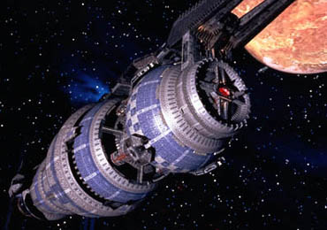
A space station can simulate the effects of gravity by rotating around an axis.
B5 starts at rest. You increase the rotational speed at a rate of 0.3 rad/sec every minute.
How many revolutions does space station make over this 120 second period?

Slide 13
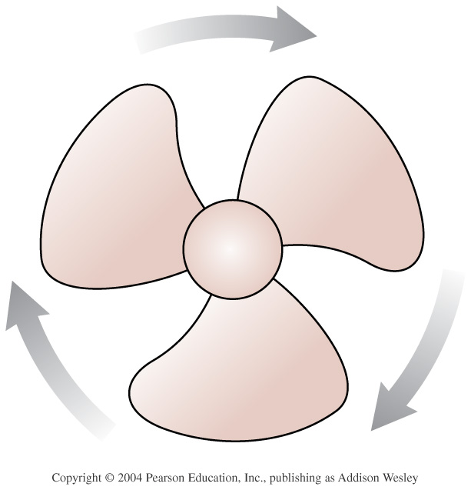

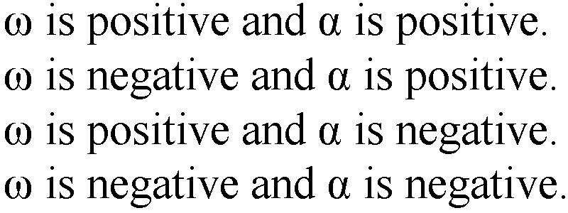
The fan blade is slowing down. What are the signs of
1.
2.
3.
4.
Notes:
STT13.1

Slide 14
Let’s try another sample problem:
A CD in your computer is spinning at 100 radians per second.
The drive applies a constant brake to the CD causing it to come to a stop after only 5 rotations.
a. How many seconds does it take for the CD to come to a stop?
b. What is the angular deceleration caused by the brake?

Slide 15
Thus far we have:
Discussed how to describe rotational motion using graphs.
Discussed how to describe rotational motion using derived equations.
Now we will discuss what causes rotational accelerations to happen.

Slide 16
Torque
WARNING: This has a different name in some engineering disciplines.
Torques cause angular accelerations.
Which way is the torque on the board pointing?
Towards the board
Away from the board
Up
Down
Right
left

Slide 17

Let’s try a sample problem:
12.64 A kid and his tiger (mass = 20kg) are walking out on a 5-meter beam (mass = 40kg) balanced on two posts that are spaced 3 meters apart as shown. How far out can they walk, until the beam begins to become unbalanced?

Slide 18
Let’s recap what we’ve learned so far:
For many linear concepts we covered last term in Ph 211, there is now a rotational analog:
s → θ; v → ω; a → α; F = ma → τ=Iα
The torque on an object can be found using
3) In order for a system to be in equilibrium then:
ΣF=0
Στ = 0

Slide 19
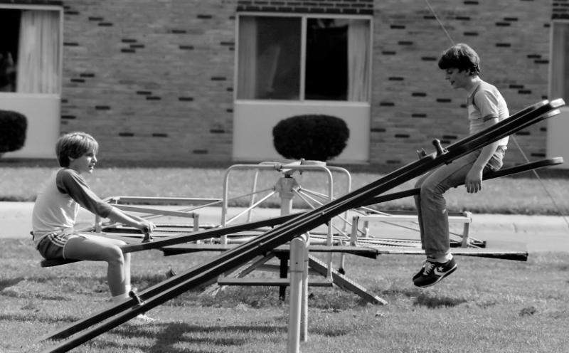
In order to better understand systems of particles, we need to more fully discuss the concept of Center of Mass.
Sec. 13.2

Slide 20
M_{sue}=3m
m_{Greg}=m
m = 20kg
d=4meters
Let’s find the center-of-mass of these two children on a massless teeter-totter.

Slide 21
Of course, sometimes you need to worry about all 3-dimensions of an object and thus you need to find the Center-of-Mass in each dimension.

Slide 22
If you want to find the center of mass of an ROV, you need to check out each dimension individually.

Slide 23
Of course, not every problem in the world consists of an easily countable number of particles, thus, to find the center of mass of an object we need to
integrate!
Tell me what “dm” means.
http://www.regentsprep.org/Regents/physics/phys06/acentomas/default.htm

Slide 24
Let’s try finding the Center of Mass of a uniform ruler

Slide 25
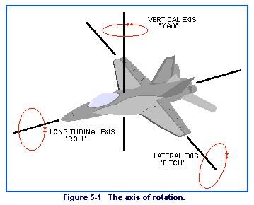
Kinetic Energy and Moment of Inertia
Let’s take a look at the Kinetic Energy in a rotating object.
In order to find the rotational Kinetic Energy of this jet about an axis we need to add the individual rotational KE of every single atom in the jet.

Slide 26
Let’s start by looking at a single particle in the airplane rotating a distance r from the center of rotation.
We are going to define the Rotational Inertia of a single point mass about an center of rotation is I_{pointmass}=mr².

Slide 27
To find the I of an object you need to find the integral:
Right side of class: Find the moment of inertia of a ruler about its center point.
Left side of class: Find the moment of inertia of a ruler about its end point.

Slide 28
I is the “Moment of Inertia” of an object.
Thin hoop
solid
hollow
13.4

Slide 29
Let’s try finding the moment of inertia of an ice skater.
The total Moment of Inertia is the sum of the component moments of inertia.

Slide 30
Let’s recap where we are so far:
First, just as in Ph 211, we considered motion:
Next, just as in Ph 211, we looked at the “cause” of motion:
At the end of Ph 211 we discovered that conserved quantities can often make our life easier:

Slide 31
Sample Problem 4:
Find the minimum height a solid marble of mass m and radius r needs to get around a loop-d-loop of radius R.

Slide 32
Let’s recap where we are so far:
First, just as in Ph 211, we considered motion:
Next, just as in Ph 211, we looked at the “cause” of motion:
At the end of Ph 211 we discovered that conserved quantities can often make our life easier:

Slide 33
Angular Momentum, also called Spin, is a:
conserved quantity
vector quantity
Just like linear momentum, angular momentum is very useful in particularly those problems that involve collisions and “explosions”.

Slide 34
Let’s recap where we are so far:
First, just as in Ph 211, we considered motion:
Next, just as in Ph 211, we looked at the “cause” of motion:
At the end of Ph 211 we discovered that conserved quantities can often make our life easier:

Slide 35
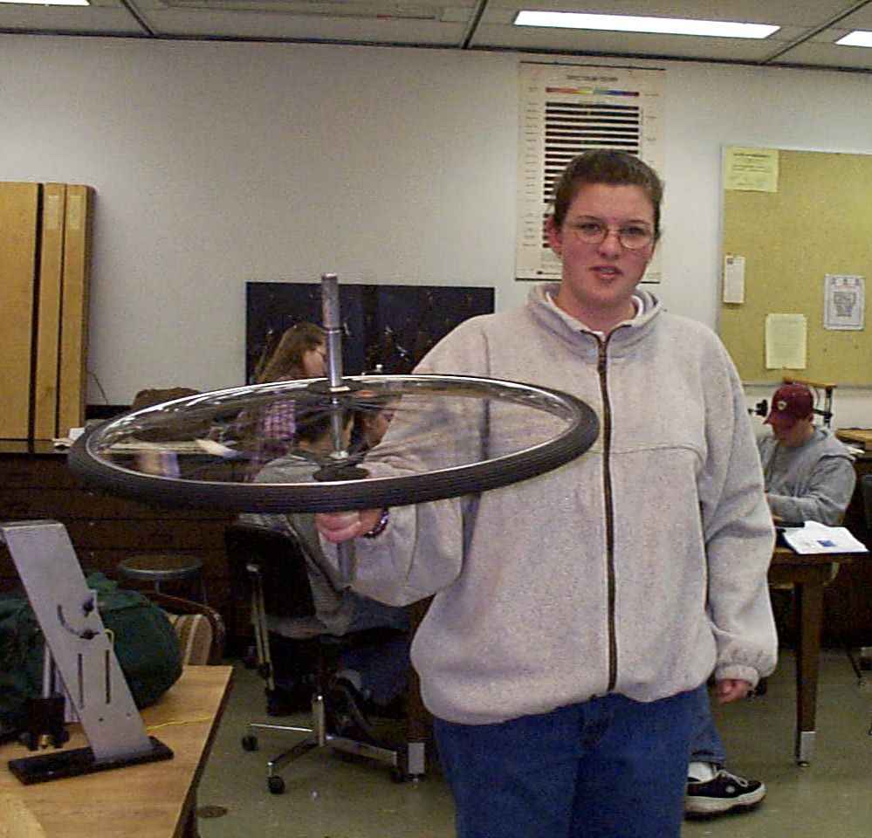

You are going to sit on a stool that can rotate about a central axis. I am going to hand you a bicycle tire that is spinning counterclockwise as shown in the photo. Which way will you spin after is flipped over?
Clockwise
Counterclockwise
Neither

Slide 36
Sample Problem 5:
You are holding onto two 3kg masses with your 1 meter long arms out while spinning at a rate of one revolution per second.
Treat your 60kg body as a cylinder of radius 0.3meters.
How fast will you be spinning after your bring your arms in so that the two masses are now close to your chest?

Slide 37
Sample Problem 6:
You are on merry-go-round of mass M and radius R rotating as speed ω_{o}. You (of mass m) go flying off. What is the platform’s new ω_{f}?
http://www.youtube.com/watch?v=KHmWfEQpFY8&feature=related

Slide 38
An old fashioned record player turntable with a radius 30cm is spinning at 33 rpm and has a mass of 100grams.
A kitten (m_{k}=200grams) falls out of the air and lands directly on the edge of the turn table.
How fast is the turn table turning after the collision.

Slide 39
Forces cause accelerations.
Torques cause angular accelerations

Slide 40
Let’s try analyzing yesterday’s situation in Lab.
Our goal was to measure the moment of inertia of the thick hoop.
Let’s remember our General Problem Solving Steps:
Draw a picture!
Set up a “good” coordinate system
Draw a FBD for every body in the problem.
If a body is being “torqued”, clearly denote your torque vectors.
See if you can use a conservation law to make your life easier.
Create an equation using F_{net} = ma_{net} for every body in the problem.
Create an equation using τ_{net} = Iα_{net} for every torqued body in the problem.
Always check to see if you have constant accelerations or changing accelerations.

Slide 41
Enter Question Text
1
2
3
4

Slide 42
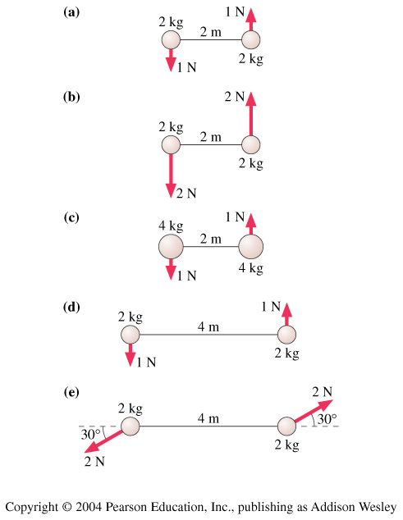

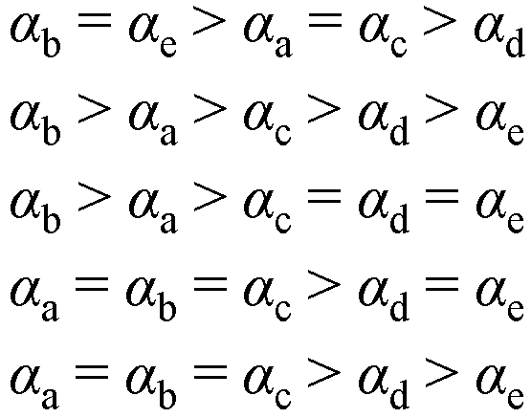
Rank in order, from largest to smallest, the angular accelerations
1.
2.
3.
4.
5.
Notes:
STT13.3

Slide 43
Torques cause angular accelerations:
τ = I α
13.5

Slide 44
Objects in equilibrium:
If an object is in equilibrium, not only do the forces have to add up to zero, but the torques must add up to zero as well.
13.6

Slide 45
An object rolling or rotating also has a Rotational Kinetic Energy. KE = ½ I ω².
13.7-13.8

Slide 46
When rotating things collide (or explode) you must take angular momentum into consideration.
13.9-13.10

Slide 47
A hoop of mass m and radius R is rolling (without slipping) down a inclined plane L meters long at an angle of θ with respect to the horizontal.
At what speed v is the hoop traveling when it leaves the ramp?

Slide 48
An eraser of m = 100 grams is dropped on a record player platform of m=500 grams that was rotating at 33rpm. What is the new rotational speed of the eraser and platform?

Slide 49
A space station shaped like a giant wheel has a radius of 100 m and a moment of inertia of 5.00 · 10⁸ kg·m². A crew of 150 people are living on the rim and the station’s rotation cause the crew to experience an acceleration of 1g. When 100 people move to the center of the station for a station meeting, the angular speed changes. What acceleration is experienced by the people who remain at the rim? The average mass of each inhabitant is 65.0 kg.
Step 1: Draw a picture and list what is known.
Step 2: Determine the ω_{o} of the system from the 1g

