Slide 1
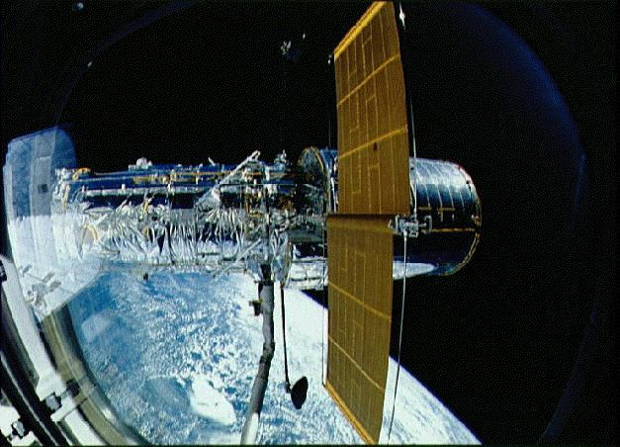
Chapter 36—Optical Instruments

Slide 2
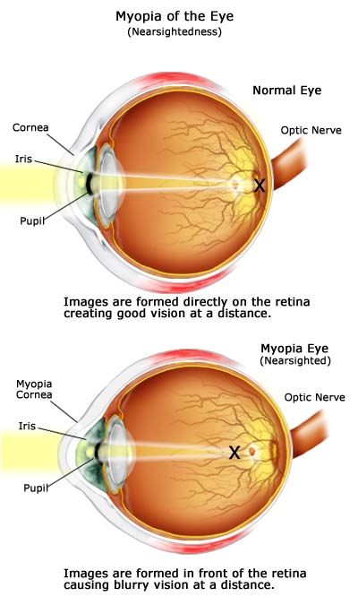

Slide 3
The Electromagnetic Spectrum
Wavelength =
~700nm
~350nm
AM
FM
TV
Microwaves
Infra-red
Ultra-
violet
X-Rays
Gamma-
Rays
Low Energy
Long Wavelength
Low Frequency
High Energy
Small Wavelength
High Frequency

Slide 4
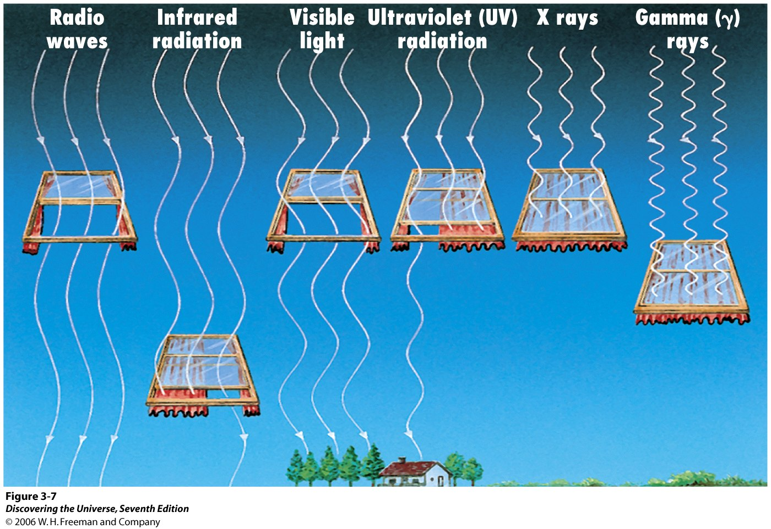

Slide 5
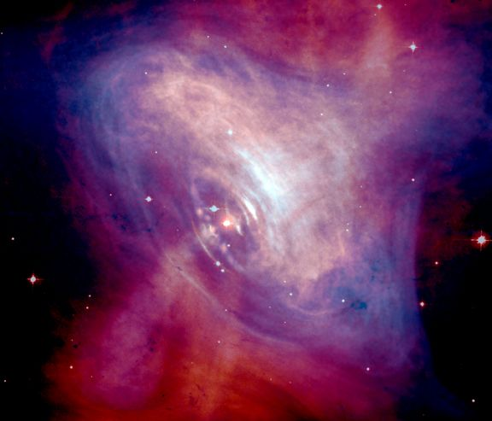
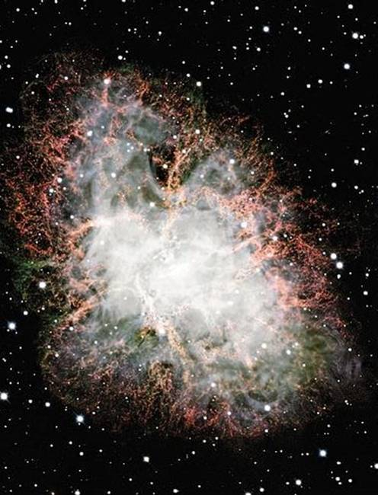
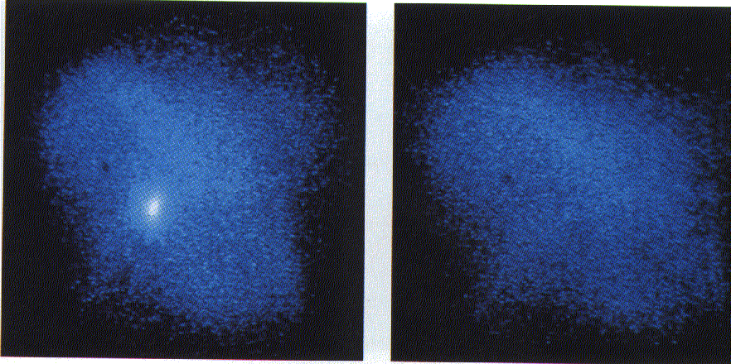
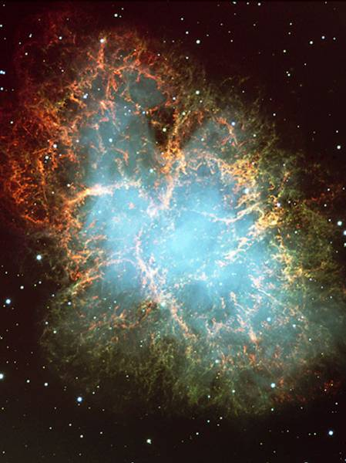
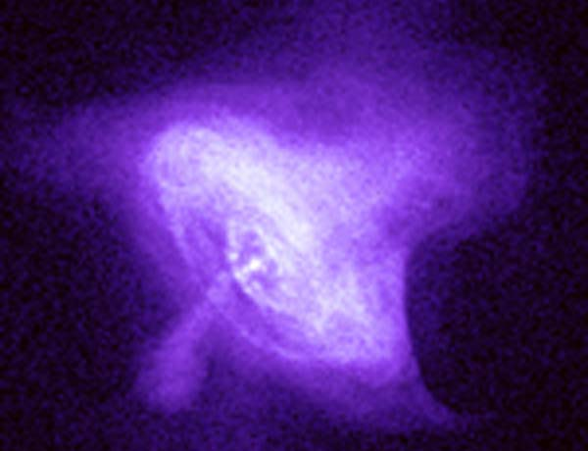
In Astronomy, images can be made of distant object using all different parts of the electromagnetic spectrum.
R
I
V
U
X
G
Radio
Infrared
Visible
Ultraviolet
XRays
Gamma Rays

Slide 6
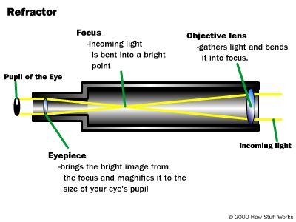
Refracting Telescopes also called Galilean Telescopes
R
I
V
U
X
G

Slide 7
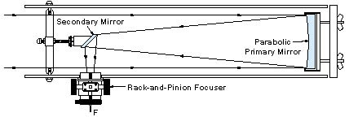
Reflecting Telescopes
also called Newtonian Telescopes
R
I
V
U
X
G

Slide 8
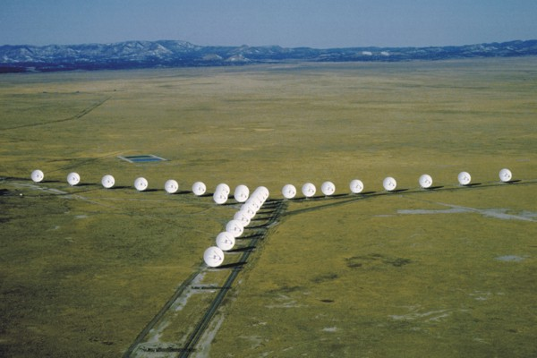
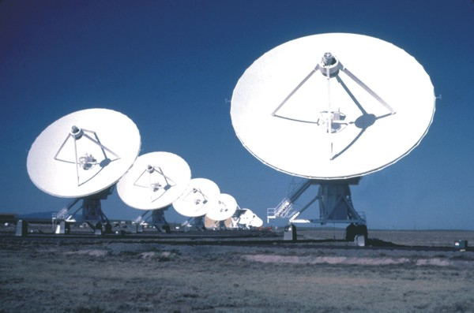
Radio Telescopes
Images courtesy of NRAO/AUI
http://www.vla.nrao.edu/

Slide 9
Radio Telescopes
R
I
V
U
X
G
The Crab Nebula

Slide 10
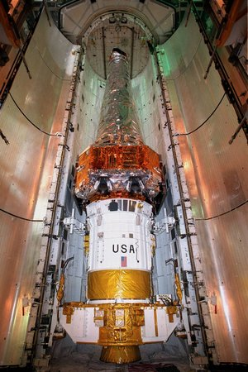
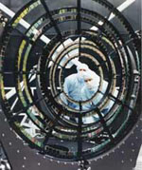
X-Ray Telescopes
The Chandra Space Telescope

Slide 11
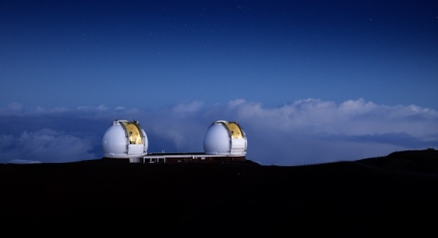
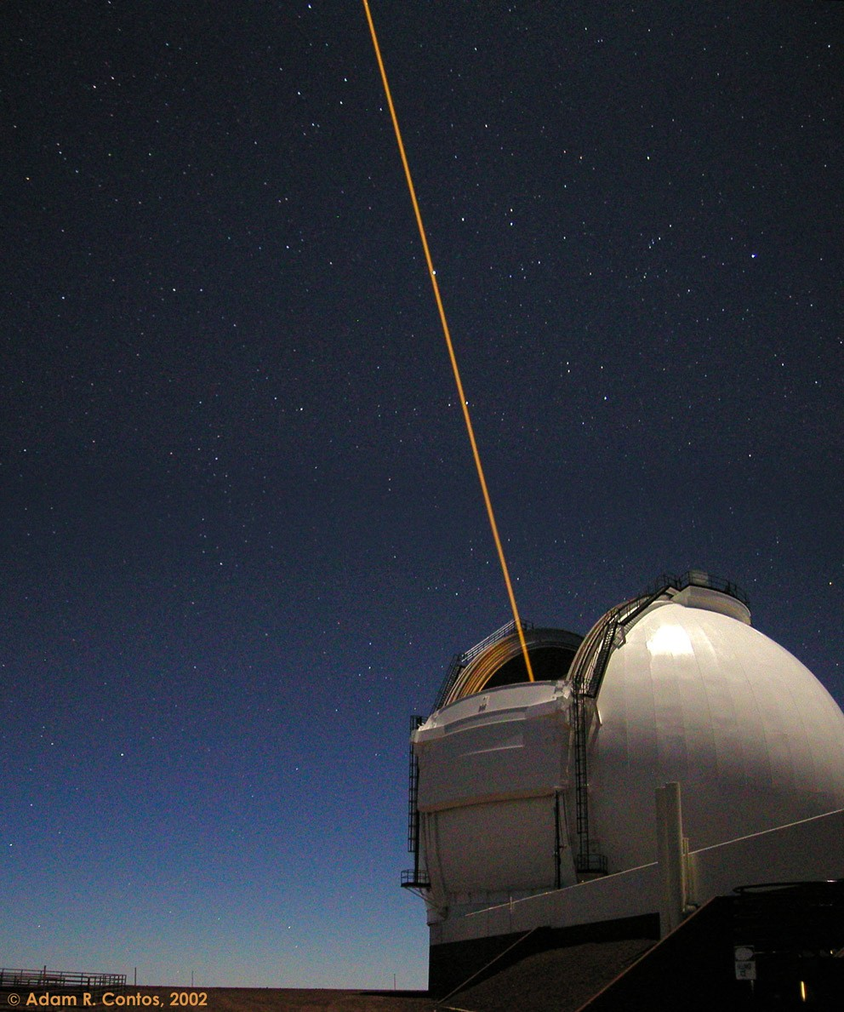
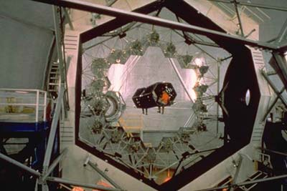
Adaptive Optics

