Slide 1
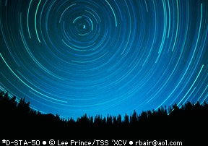
Welcome to Ph 212

Slide 2
Chapter 13
Newton’s Law of Universal Gravitation
Or,
All of Ph 211 with Gravity

Slide 4
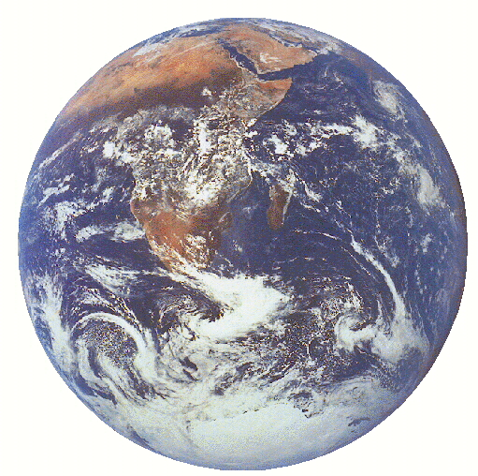
One prominent model that explained the motion of the stars at night.

Slide 5
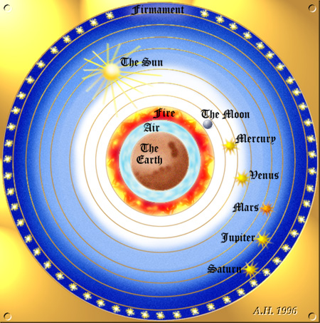
A guy named Aristotle messed us up nearly 2000 years ago with his model of the Universe that put the Earth and the center of everything.
In this “Crystalline Sphere” model, Earth was surrounded by a set of crystal spheres upon which the sun, moon, and stars all moved.
http://www.youtube.com/watch?v=RLPVCJjTNgk
Sec. 12.1

Slide 6
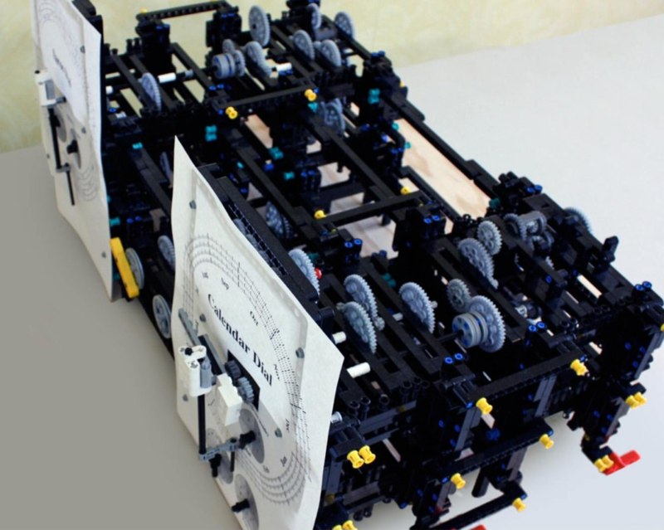
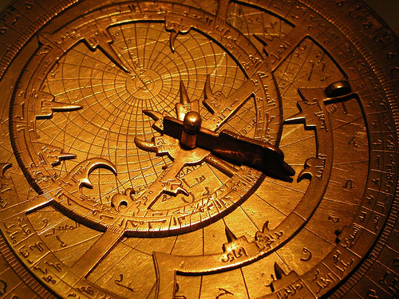
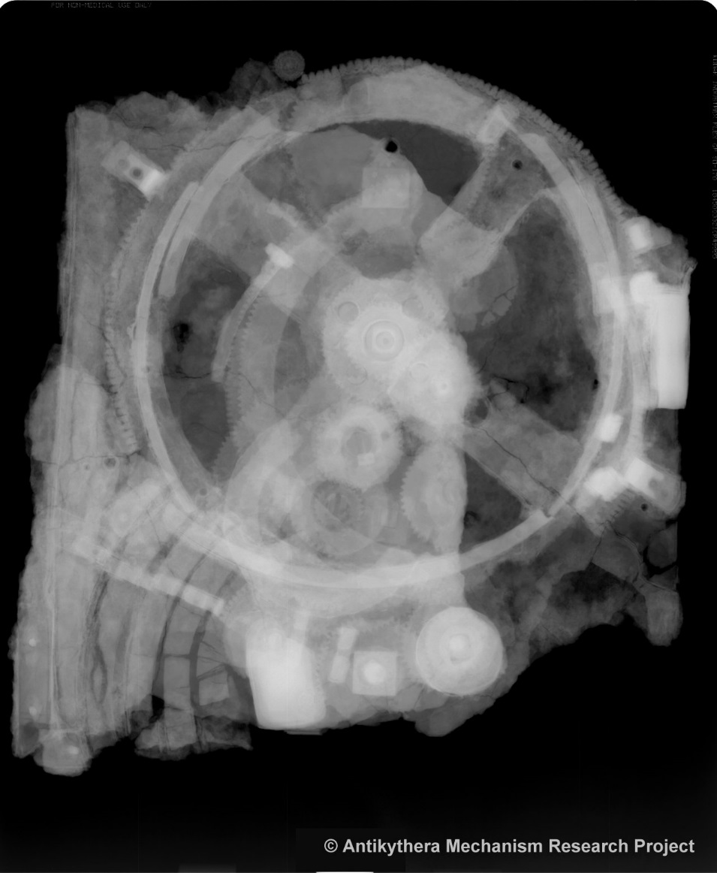
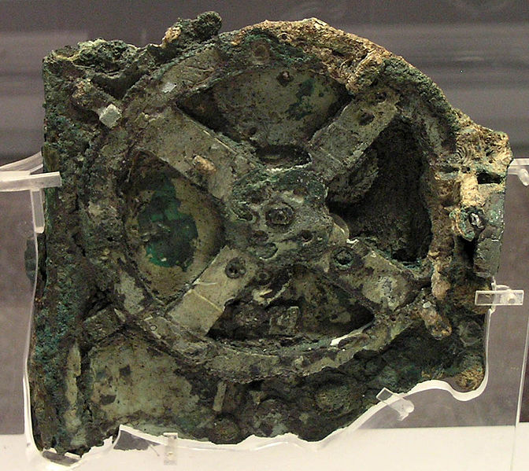
Antikythera Mechanism from ~ 100B.C.

Slide 7
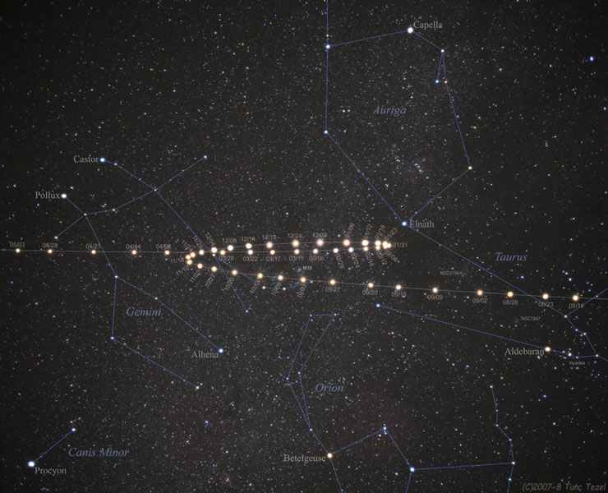
The problem with this model is that it doesn’t well predict the motion of the Planets.
Observed Retrograde Motion of Mars

Slide 8
Remember that a Scientific Model should:
Describe
Explain
Predict
Be Verifiable
Be Changeable

Slide 9
Mars as seen from Earth
Path of
3
2
1
Observed
4
7
6
5
Mars Orbit
4
5
Earth Orbit
3
6
2
7
Sol
1
How we view the
Solar system today.
http://www.mhhe.com/physsci/astronomy/applets/Retro/frame.html

Slide 10
Aristotle’s Geocentric Model of the Universe did a fairly good job of predicting the motions of the stars, sun and moon for a good century into the future. With some modifications, it even predicted the motion of the planets.
However, those people who had access to centuries of astronomical data discovered that Aristotle’s model couldn’t be correct. However, in Europe, any suggestion that the Earth wasn’t the center of everything would result in a quick death-sentence by the church-state of the time.
One of the dissenters was a person name Nicholas Copernicus. Copernicus developed some fairly sophisticated mathematics that showed that the Earth can’t be the center of the Solar System. He waited until he died until he published his result. Thanks to the newly invented printing press

Slide 11
Kepler’s Laws:
#1) The planets move in elliptical orbits with the sun at one focus of the ellipse.

Slide 12
Kepler’s Laws:
#2) A line drawn between the sun and a planet sweeps out equal areas during equal intervals of time.
.

Slide 13
Kepler’s Laws:
#3) The square of a planet’s orbital period is proportional to the cube of the semimajor-axis length.
It runs out that:

Slide 14
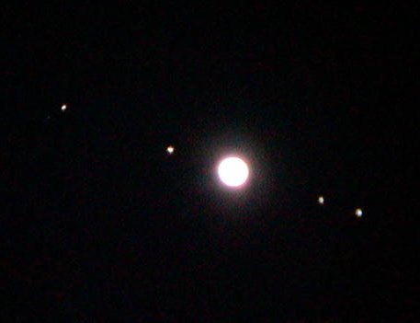
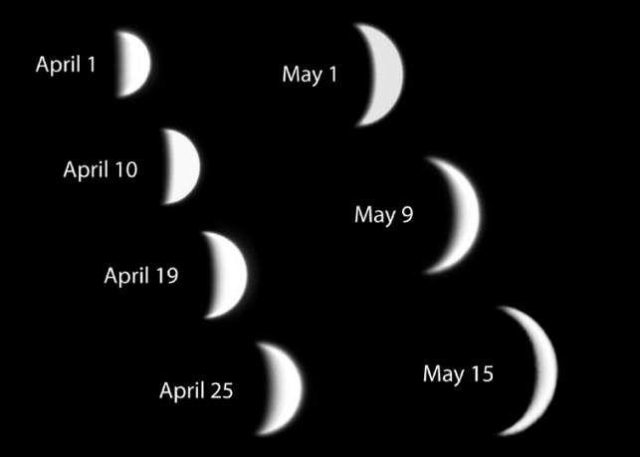
Galileo’s use of the telescope helped even more when he came up with images like this:

Slide 15


It took Newton to unite the mathematics and the observations -- in the process he created what we today call physics and calculus.
Sec. 13.2

Slide 16
Newton’s Laws:
The force is inversely proportional to the square of the distance between the objects.
The force is directly proportional to the product of the masses of the two objects.
Sec. 13.3

Slide 17
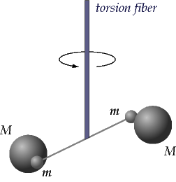
Big G is measured by the Cavendish Experiment
G = 6.67*10⁻¹¹ Nm²/kg²
http://www.leydenscience.org/physics/gravitation/cavend.htm

Slide 18
We, even today, make some assumptions about Newton’s Theory of Gravity:
That the equation is correct.
That m_{inertial}=m_{gravitational}
It works everywhere.

Slide 19
Newton’s Theory of Gravity Assumption 1:
The equation is correct:
Let’s use this equation to determine the mass of the Earth.
We also can observe that it takes the moon about 27 days to orbit the Earth.
Example Problem 1: From the retroreflectors the astronauts left on the moon we know that it takes roughly 2.56 seconds for light from here to get to the moon and back.
From the torsion balance experiment, we know that G=6.67·10⁻¹¹Nm²/kg² .
We also know c= 3.0∙10⁸m/s
Sec. 13.4

Slide 20

Which Force is Larger?
F_{eonm} is larger
F_{mone} is larger
Both are equal

Slide 21
Newton’s Theory of Gravity
Assumption 2:
That m_{inertial}=m_{gravitational}
Let’s figure out what this means.
Newton was the one who gave us F = ma
m_{inertial}
He also gave us
m_{gravitational}
Cavendish’s Experiment, is still the best to test this.

Slide 22
But, if m_{inertial}=m_{gravitational} then, we can use the two interchangeably and do all sorts of neat things with stuff we already know.
For example, let’s try to get off the earth.
We are going to have to have to do some work to get off the planet.
From Ph211 we know that W = F·s
Or, more accurately:
Sec. 13.5

Slide 23
Note something that might seem weird here:
Note the negative
Usually, we define the “zero point” of Universal Gravitational Energy to be at
Thus:

Slide 24
Universal Gravitational Potential Energy
Energy
r
TE
PE

Slide 25
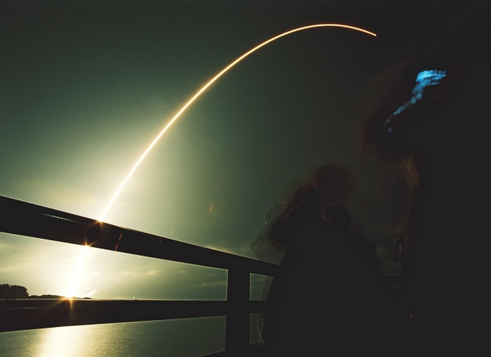
Sample Problem 1:
Find the escape velocity from Earth’s surface.
Messenger Launch 3.Aug.2004

Slide 26
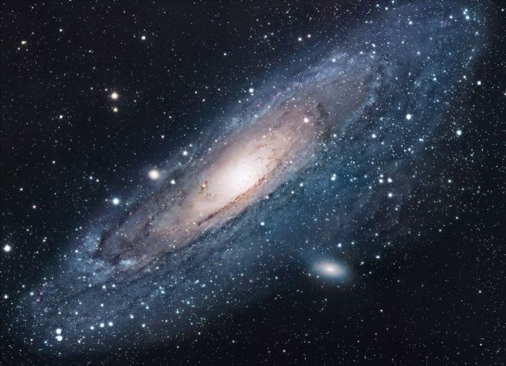
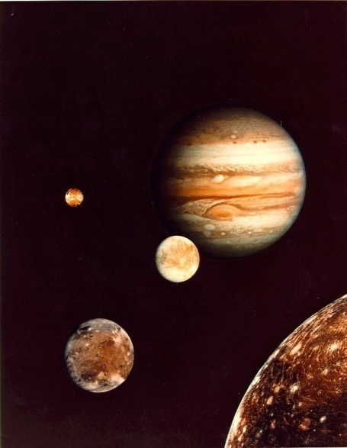
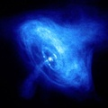
Newton’s Theory of Gravity Assumption 3:
Gravity works the same everywhere.
We can use Newton’s Law of Gravity on everything from an apple to a galaxy!
Sec. 13.6

Slide 27
The gravitational force between two objects can be expressed as
Using the definition of Work we can integrate the Force and define Universal Gravitational Energy as
Our problem solving strategies that we developed in Ph 211 work just fine for problems dealing with gravity.
Let’s summarize what we have covered so far:

Slide 28
Sample Problem 2:
We live in a system of 3 suns just like Sol. The 3 suns all orbit in a circular orbit around each other with a radius equal to Earth’s radius around Sol.
Find the period of orbit of the 3 suns.

Slide 29
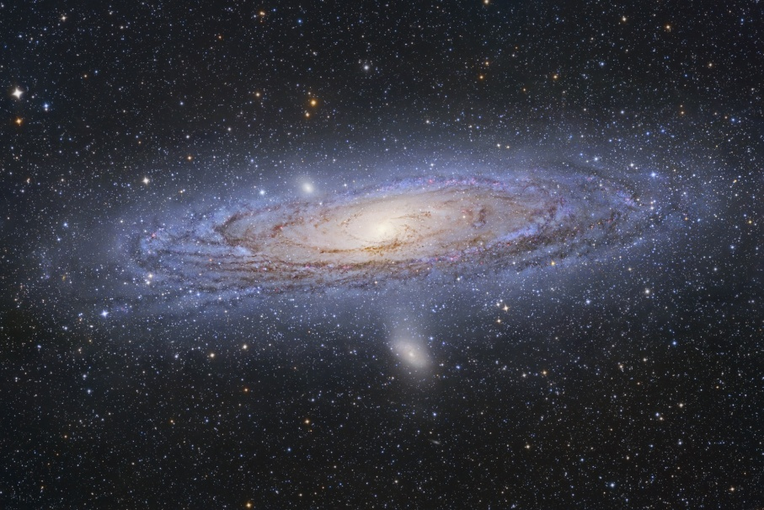
Sample Problem 3:
Let’s try finding the mass of the Andromeda Galaxy.
Using Cepheid Variable Luminosity methods, we can find that the Andromeda galaxy is (2.51±0.13) million light years away. The halo of the Andromeda seems to be (2.22 ±0.56)·10⁵ lt-years from side to side and a star in the halo has an orbital speed of (0.07±0.03)% the speed of light.
Draw a picture.
Draw a FBD.
Use and derive equations.

Slide 30
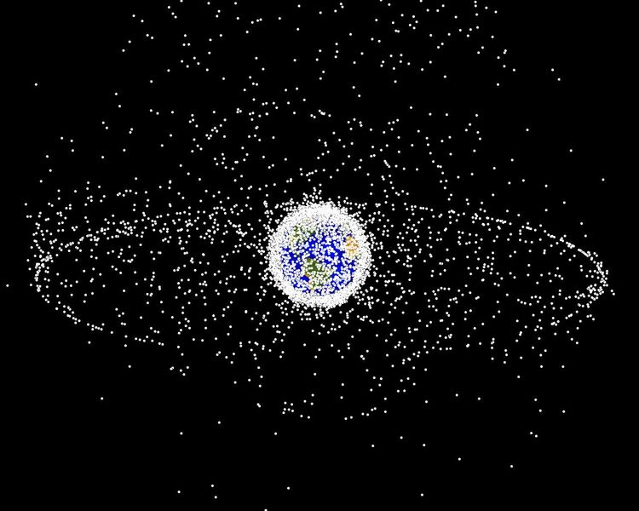
Sample Problem 4:
Calculate the altitude of a satellite in geosynchronous orbit.
Lab Extra Credit: Create a VPython program that clearly demonstrates a satellite in geosynchronous orbit.

Slide 31
r = 4.2·10⁷m

Slide 32
Sample Problem 5 (Knight 13.46)
A 4000kg lunar lander is in a circular orbit 50km above the surface of the moon. It needs to move out to a 300km-high orbit in order to dock with the mother ship that will take the traveler home.
How much work must the thrusters do?

Slide 33
The gravitational force between two objects can be expressed as
Using the definition of Work we can integrate the Force and define Universal Gravitational Energy as
Our problem solving strategies that we developed in Ph 211 work just fine for problems dealing with gravity.
Let’s summarize what we have covered so far:

Slide 34
Let start today with a conceptual question.
Those of us who have spent time on the coast know that there are approximately two high tides a day (specifically 12 hours and 25 minutes apart).
Explain this observation.
http://astro.unl.edu/classaction/

Slide 35
Where is the moon when it is full?

Slide 36
You are in Newport. When will a high tide happen if it is a full moon tonight?
6am
Noon
6pm
Midnight
1 & 3
2 & 4
1 & 2
1 & 4
2 & 3

Slide 37
PRS Question:
A
You and a space ship are in circular orbits around Earth.
You are in a higher orbit than the space ship going in the same direction as the spaceship.
Of the four possible directions denoted above, which way do you want to point your thruster?
D
B
C

Slide 38
Which is the strongest force:
1. Gravitational Force
2. Magnetic Force
3. Electric Force
Nuclear Strong Force
Nuclear Weak Force

Slide 39
Which is the strongest force:
1. Gravitational Force
2. Magnetic Force
3. Electric Force
Nuclear Strong Force
Nuclear Weak Force
EM Force
Grand Unified Theory (GUT) Theory of Everything (TOE)

